Slide 1
Risk Management
Ken Abbott
ken.abbott@barclays.com
abbottkc@gmail.com
212 762 4176 w
917 714 4810 m
973 701 1753 h

Slide 2
Syllabus
Mission, Principals, & Interaction
EDA
Methodology
V/CV
Monte Carlo
Hist Sim
Stress Testing
Limits
Models
Buy Side
Reg Issues

Slide 3
Overview
Institutional
Statistical
Methodological
Procedural
Regulatory

Slide 4
Mission, Principles, & Interaction

Slide 5
Risk Management's Mission
To ensure that management is fully informed about the risk profile of the bank.
To protect the bank against unacceptably large losses resulting from concentration of risks
In other words:
NO SURPRISES
Two analogies:
Spotlight
Color filter

Slide 6
Risk Management is not risk avoidance!
Take the bet but understand
Reasoned analytics?
Pure speculation?
Guy down the street does it?
Worked last time?
Been a client for a long time?
Why do the Trade?
What do you expect to make?

Slide 7
Five Key Questions
Did we know what bet we were making?
Did the right people discuss the risks?
Was the position within established limits?
Was the risk/reward ratio appropriate?
Was it a bet we could afford to make?

Slide 8
Risk Management Should...
Monitor market conditions
Set, monitor, and enforce limits
Have complete access to systems
Calculate risk figures & run stress tests
Play a role in model validation
Play a role in product development
Liaise with regulators
Link all control functions
Have continuous dialogue with management

Slide 9
Risk Management Should NOT... (some opinions)
Report to business line
Be responsible for stop-loss limits
Have final responsibility for pricing
Create and own risk feeds

Slide 10
Analysis: The Toolkit
Sensitivity Analysis
VaR
Stress Tests
Scenario Analysis
Backtesting
Risk/Return Analysis
Economic Analysis
Common Sense

Slide 11
Implementation: The Toolkit
Limits
Concentration Tests
Capital Charges
Earnings Recognition
Policies, Procedures, and Standards
Education
Planning Process
Management Reports and Review
Moral Suasion

Slide 12
Brief History – 1980s
Year
Market Events
Risk Management Events
Risk Management Evolution
Evolution of Derivatives
Early 80s
Reaganomics
Bank Deregulation
Latam Crises
Limited Number of Market Risk Businesses
Geographic Concentration in U.S.Few Major Risk Takers
Informal Process for Managing Risk in Decentralized Organization
Black Scholes
Loan Trading
First Risk Management Teams
Credit Risk Management
1985-86
Plaza Accord
Balance Sheet Based Management
1987
Stock Market Crash
Portfolio Crisis
Savings and Loans Crisis
Greater Product Diversity and Complexity
Greater Geographic Diversity
Many Risk Takers
How to Run a Globally Decentralized Risk Org
1988
Stock Market Crash
Basel I
BT NZD Event

Slide 13
Brief History – 1990s
Year
Market Events
Risk Management Events
Risk Management Evolution
Exotic Derivatives
Early 90s
Japanese Bubble
High Yield Collapse
Establishment of derivatives “culture”
Reaction to scandals
Development of vendor solutions
Acceptance of BIS methodology
Rise of risk management as an independent discipline
Reaction to several market crises
(Rise and fall of emerging markets)
How to institutionalize the risk process
Mid 90s
Bond Market Crash
Nick Leeson / Barings Collapse
Off-The Shelf Solutions
Bank Expansion into Derivatives
Market Risk Amendment
Credit + Market Risk Management
1997 1998
Asia Market Crash
IMF intervention in Asia
Risk Sensitivity Based Management
Emerging Markets / High Yield Crisis
LTCM collapse
Russia Defaults

Slide 14
Brief History – 2000s to Current
Year
Market Events
Risk Management Events
Risk Management Evolution
Enron
Argentina Defaults
Sarbanes Oxley
EITF 0203
Tech Bubble Burst
Subprime Expands
Development of CDOs
Early 00s
2005
1st Credit Derivatives Crisis
Statistical Arbitrage
Credit + Market + Operational Risk Management
2007 2008
Subprime Crisis
Model-Driven P&L
Financial Crisis
Bear Stearns, Lehman, AIG, Wachovia, Bernie Madoff
Stress Testing Based Management
Operational Risk Incidents:
Société Générale
UBS
JP Morgan
LIBOR
Mortgage settlements
Establishment of derivatives “culture”
Reaction to scandals
Development of vendor solutions
Acceptance of BIS methodology
Rise of risk management as independent discipline
Reaction to several market crises
(Rise and fall of emerging markets)
How to institutionalize the risk process
2011
Eurozone Crisis

Slide 15
Why So Many Crises ? Why So Many Losses?
Mean Reversion
Any stochastic process creates volatility but eventually reverts to the mean
People tend to attach “stories” to random processes
External Shocks / Innovations Create Opportunities and Overshooting
Financial innovation for efficient risk taking
New regulations create new opportunities
Incentives
Herd mentality
Behavior In Crises
Irrational behavior in disaster
Panic
Denial
Chain Reaction

Slide 16
Organization of the Risk Function
Alignment with business line vs. centralized function
“Risk Control” vs. “Risk Management”
Policemen vs. facilitators
Product orientation vs. business hierarchy orientation
Market Risk and Credit Risk combined

Slide 17
A Typical Firm Risk Management Structure
Firm Risk
Operational Risk
Credit Risk
Market Risk

Slide 18
A Typical Operational Risk Management Structure
Operational Risk
Capital
Risk Managers
Data & Metrics
Modeling
Governance

Slide 19
A Typical Credit Risk Management Structure
Credit Risk
Lending Risk Managers
Counterparty Risk Managers
Policy & Governance
Research & Ratings Analytics
Corporate
Tailored
Reporting & Capital
Model Review

Slide 20
A Typical Market Risk Management Structure
Market Risk
Product Level Risk Managers
Policy & Governance
Research & Analytics
Reporting & Portfolio Analysis
Capital
Model Review

Slide 21
A Typical Market Risk Management Structure
Product Risk Managers
Co-located with various business units to provide risk analysis and monitoring
Cover individual products / desks and evaluate risk at the trade level
Work with business unit to establish limit structure
Portfolio Analysis & Risk Reporting
Analyze and manage firm's trading, lending, investment and counterparty risks as a portfolio
Aggregate and report these risks across asset classes and business lines
Establish and maintain robust risk data standards and repositories
Produce independent risk reports for Senior Management, business line, and regulatory disclosure purposes
Establish and maintain risk data standards for reporting
Perform Firm-Wide analysis of market sensitivity and concentration
Performs market risk capital calculations for regulatory purposes and strategic capital planning
Policy and Governance
Sets forth principles and practices for sound market risk management at MRD
Information Technology
Responsible for implementation and maintenance of the software supporting MRD’s risk databases, VaR process, capital processes and other related analytical tools

Slide 22
A Typical Market Risk Management Structure
Research & Analytics
Analytics:
Responsible for specifying and implementing methodologies used to calculate risk statistics for market risk, as well as other stress measures
Maintain time-series database underlying various risk models
Model Review:
Responsible for the independent review of pricing models
Confers with Risk Managers to ensure signoff on model-related issues
Ensures that model documentation complies with both internal and regulatory standards

Slide 23
Risk Primary Interfaces
Line (Front Office):
Traders
Trading Managers
Senior Management
Business Managers
Investment Bankers
Portfolio Managers
Clients

Slide 24
Interaction
Compliance and Legal
suspicious trades
wall issues
exchange & regulatory policy
Conduct
Volcker
Regulators
FRB FINRA CFTC
SEC OCC FERC
PRA FSA (Japan) Basel
FCA BAFIN State Regulators
FDIC Other CB’s Insurance Regulators

Slide 25
Interaction
IT
budget
architecture
new hardware and software
connectivity
WWW
vendor selection & contracts
storage

Slide 26
Interaction
Ops (Back Office) /Middle Office
data feeds
reconciliation
clearance & settlement
price verification
accounting policy
back testing data

Slide 27
Interaction with Risk Areas
Counterparty Credit Risk
DCE calculation & methodology
Aging policies
haircuts
credit VaR
collateral issues
credit policies

Slide 28
Interaction with Risk Areas
Operational Risk
OpVar
RCSA
Scenario Analysis
KRIs
Control issues
Policy and Procedure
Forensic issues

Slide 29
Risk Committees
Board of Directors
Committees by Product
Committees by Region
Senior Management
Special Committees
Op Risk
New Products
Reputation Risk
Loan Committees

Slide 30
The Importance of Communication
Quants typically suck at communication
Your bosses often won’t have advanced degrees
Senior management almost certainly won’t
Communicating to management requires a specific set of skills
It is VERY different
The stakes are very high
You have to get their attention very quickly
You have very little time to make your point
For every greek letter you show, you’ll lose 25% of your audience
Clear graphics are KEY (more on this later)
Communicating with other groups require different approaches
Lawyers Controllers / Accountants
Junior staff Auditors
Administrative staff Regulators

Slide 31
Games Traders Play
“You don’t have my positions recorded correctly.”
“It’s not underpriced, I’m just being conservative.”
“You’re overstating my risk.”
“I need to trade this (unrelated) product.”
“I was always allowed to do this at _______”
“I already got limit excess approval.”
“We need to calculate our own VaR.”
“You’re overallocating expenses to me.”
“Do you know how much I made trading this last year?”
“You’re trying to kill my business.”

Slide 32
A word on ethics…
Character is what we show when no one is watching
I’m not sure we can teach ethics
We can, however, teach the rules and the law
We can also provide examples
Everyone will be faced with choices
Resumes / job applications
Trading & P&L attribution
Disclosing errors
“Ownership” of errors vs subordinates
Pitching analyses to clients
The use of statistics
“spin”
Disclosure
regulatory
public

Slide 33
Exploratory Data Analysis*
*Based upon material found at http://www.itl.nist.gov/div898/handbook/eda/eda.htm

Slide 34
Approach
EDA is an approach for data analysis that employs a variety of techniques to
maximize insight into a data set;
uncover underlying structure;
extract important variables;
detect outliers and anomalies;
test underlying assumptions;
develop parsimonious models; and
determine optimal factor settings.
EDA postpones usual assumptions about what kind of model the data follow with the more direct approach of allowing the data itself to reveal its underlying structure and model.
EDA is a philosophy as to how we dissect a data set; what we look for; and how we interpret.

Slide 35
History
The seminal work in EDA is Exploratory Data Analysis, Tukey, (1977).
Over the years it has benefited from other noteworthy publications such as
Data Analysis and Regression, Mosteller and Tukey (1977),
Interactive Data Analysis, Hoaglin (1977),
The ABC's of EDA, Velleman and Hoaglin (1981)
It has gained a large following as "the" way to analyze a data set.

Slide 36
Techniques
Most EDA techniques are graphical in nature with a few quantitative techniques.
The reason for the heavy reliance on graphics is that by its very nature the main role of EDA is to explore with an open-mind.
In combination with the natural pattern-recognition capabilities that we all possess, graphics provides, of course, unparalleled power to carry this out.

Slide 37
Techniques
The particular graphical techniques employed in EDA are often quite simple, consisting of various techniques of:
Plotting the raw data such as histograms, bihistograms, probability plots, lag plots, block plots, and Youden plots.
Plotting simple statistics such as mean plots, standard deviation plots, box plots, and main effects plots of the raw data.
Positioning such plots so as to maximize our natural pattern-recognition abilities, such as using multiple plots per page.

Slide 38
EDA Goals
Primary goal: to maximize insight into a data set and its underlying structure while providing all the specific items one would want to extract from it:
a good-fitting, parsimonious model
a list of outliers
a sense of robustness of conclusions
estimates for parameters
uncertainties for those estimates
a ranked list of important factors
conclusions as to whether individual factors are statistically significant

Slide 39
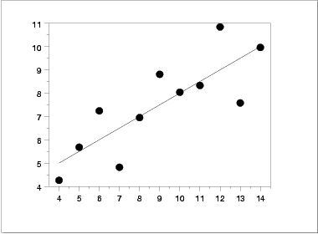
EDA/Graphics Example
Scatter Plot Suggests:
The data set "behaves like" a linear curve with some scatter;
there is no justification for a more complicated model (e.g., quadratic);
there are no outliers;
The data are equally-precise throughout and so a "regular" (that is, equi-weighted) fit is appropriate

Slide 40
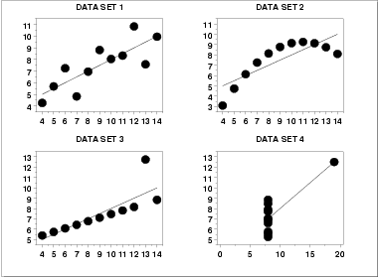
EDA / Graphics Examples
Conclusions from the scatter plots are:
data set 1 is clearly linear with some scatter.
data set 2 is clearly quadratic.
data set 3 clearly has an outlier.
data set 4 is obviously the victim of a poor experimental design with a single point far removed from the bulk of the data "wagging the dog".

Slide 41
Importance of Exploratory Analysis
These points are exactly the substance that provide and define "insight" and "feel" for a data set.
They are the goals and the fruits of an open exploratory data analysis (EDA) approach to the data.
Quantitative statistics are not wrong, but they are incomplete because they are numeric summaries
Summaries focusing on a particular aspect of the data by reducing the data to a few numbers.
location,
intercept
slope
degree of relatedness
BUT quantitative statistics focus but also filter;

Slide 42
General Problem Categories
One way of classifying our problem set:
Univariate and Control
Comparative and Screening
Optimization and Regression
Time Series and Multivariate

Slide 43
Problem Classification
UNIVARIATE
Data: A single column of numbers, Y.
Model: y = constant + error
Output:
A number (the estimated constant in the model).
An estimate of uncertainty for the constant.
An estimate of the distribution for the error.

Slide 44
Problem Classification
CONTROL
Data: A single column of numbers, Y.
Model: y = constant + error
Output: A "yes" or "no" to the question "Is the system out of control?".

Slide 45
Problem Classification
COMPARATIVE
Data: A single response variable and k independent variables (Y, X₁, X₂, ... , X_{k}), primary focus is on one (the primary factor) of these independent variables.
Model: y = f(x₁, x₂, ..., x_{k}) + error
Output: A "yes" or "no" to the question "Is the primary factor significant?".

Slide 46
Problem Classification
SCREENING
Data: A single response variable and k independent variables (Y, X₁, X₂, ... , X_{k}).
Model: y = f(x₁, x₂, ..., x_{k}) + error
Output:
A ranked list (from most important to least important) of factors.
Best settings for the factors.
A good model/prediction equation relating Y to the factors.

Slide 47
Problem Classification
OPTIMIZATION
Data: A single response variable and k independent variables (Y, X₁, X₂, ... , X_{k}).
Model: y = f(x₁, x₂, ..., x_{k}) + error
Output: Best settings for the factor variables.

Slide 48
Problem Classification
REGRESSION
Data: A single response variable and k independent variables (Y, X₁, X₂, ... , X_{k}). The independent variables can be continuous.
Model: y = f(x₁, x₂, ..., x_{k}) + error
Output: A good model/prediction equation relating Y to the factors.

Slide 49
Least Squares Fitting
Linear least squares regression is by far the most widely used modeling method.
It is what most people mean when they say they have used "regression", "linear regression" or "least squares" to fit a model to their data.
It has been adapted to a broad range of situations that are outside its direct scope.
It plays a strong underlying role in many other modeling methods, including the other methods discussed here.

Slide 50
Problem Classification
TIME SERIES
Data: A column of time dependent numbers, Y. Time is an independent variable. The time variable can be either explicit or implied. Model: y_{t} = f(t) + error The model can be either a time domain based or frequency domain based.
Output: A good model/prediction equation relating Y to previous values of Y.

Slide 51
ARIMA Models
Time series data often arise when monitoring industrial processes or tracking corporate business metrics.
The essential difference between modeling data via time series methods or using the process monitoring methods discussed earlier relates to the concepts of structure and “memory”
Time series analysis accounts for the fact that data points taken over time may have an internal structure (such as autocorrelation, trend or seasonal variation) that should be accounted for.

Slide 52
Principal Components
A multivariate analysis problem could start out with a substantial number of correlated variables.
Principal Component Analysis (PCA) is a dimension-reduction tool that can be used advantageously in such situations.
PCA aims at reducing a large set of variables to a small set that still contains most of the information in the large set
Its principal application in finance is in yield curve analysis
If you’re smart, you’ll do some background research on this topic

Slide 53
Problem Classification
MULTIVARIATE
Data: k factor variables (X₁, X₂, ... , X_{k}).
Model: The model is not explicit.
Output: Identify underlying correlation structure in the data.

Slide 54
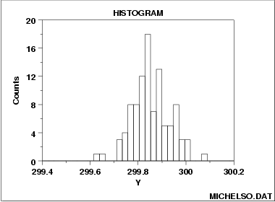
Histogram
The purpose of a histogram is to graphically summarize the distribution of a univariate data set.
The histogram graphically shows the following:
center (i.e., the location) of the data;
spread (i.e., the scale) of the data;
skewness of the data;
presence of outliers; and
presence of multiple modes in the data.

Slide 55
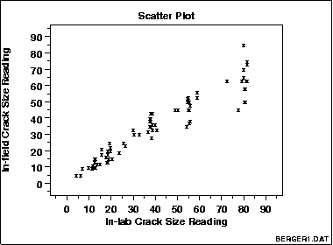
Scatter Plot
A scatter plot reveals relationships or association between two variables.
Such relationships manifest themselves by any non-random structure in the plot.
POSSIBLY THE MOST USEFUL AND POWERFUL GRAPH IN EXCEL

Slide 56
SCATTERPLOTS:
Importance of Looking at Your Data!
Elizabeth Garrett-Mayer, PhD, Director of Biostatistics, Hollings Cancer Center
Professor of Biostatistics and Epidemiology, Medical University of South Carolina

Slide 57
Transforming Variables Can Assist in Obtaining Linear Relationship
Y ~ X
log(Y) ~ X
Elizabeth Garrett-Mayer, PhD, Director of Biostatistics, Hollings Cancer Center
Professor of Biostatistics and Epidemiology, Medical University of South Carolina

Slide 58
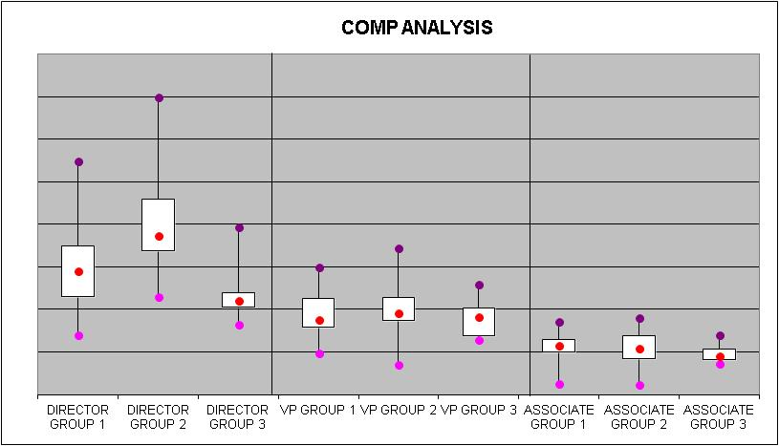
Box Plot
Box plots are an excellent tool for conveying location and variation information in data sets, particularly for detecting and illustrating location and variation changes between different groups of data.

Slide 59
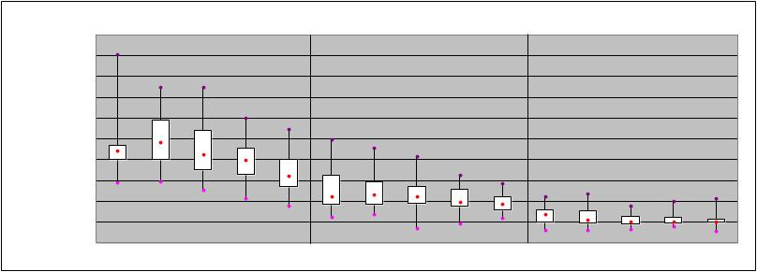
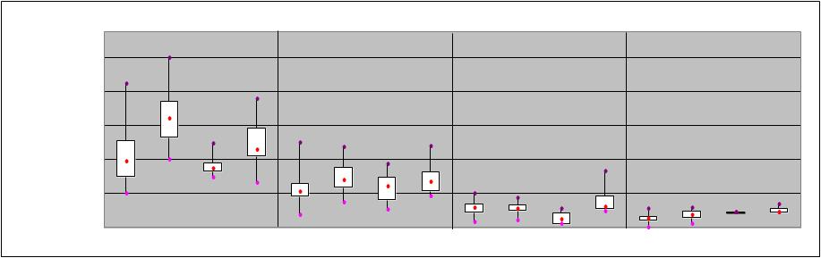
Box Plots
Time series by title
Cross sectional by title

Slide 60
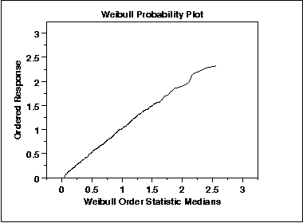
Probability Plot
The probability plot is a graphical technique for assessing whether or not a data set follows a given distribution such as the normal or Weibull.
The data are plotted against a theoretical distribution in such a way that the points should form approximately a straight line. Departures from this straight line indicate departures from the specified distribution.
The correlation coefficient associated with the linear fit to the data in the probability plot is a measure of the goodness of the fit.

Slide 61
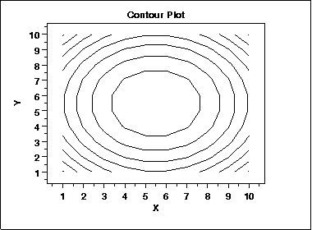
Contour Plot
A contour plot is a graphical technique for representing a 3-dimensional surface by plotting constant z slices, called contours, on a 2-dimensional format. That is, given a value for z, lines are drawn for connecting the (x,y) coordinates where that z value occurs.
The contour plot is an alternative to a 3-D surface plot.

Slide 62
Surface Plot
A surface plot is a another technique for representing a 3-dimensional surface
It is often referred to as a “heat map”.

Slide 63
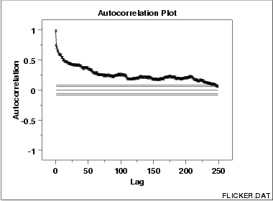
Autocorrelation Plot
Autocorrelation plots are used for checking randomness in a data set. This randomness is ascertained by computing autocorrelations for data values at varying time lags. If random, such autocorrelations should be near zero for any and all time-lag separations. If non-random, then one or more of the autocorrelations will be significantly non-zero.
In addition, autocorrelation plots are used in the model identification stage for Box-Jenkins autoregressive, moving average time series models.

Slide 64

Chernoff Faces

Slide 65
Financial EDA

Slide 66
Graphical Analysis: Time Series
Key Caveats
scale
readability
colors
complexity
outliers
“density”
need dual axis?
units
x axis skip
markers
axis labels
line thickness

Slide 67
Graphical Analysis
Scatterplot

Slide 68
Graphical Analysis
Scatterplot & 45º line

Slide 69
Graphical Analysis
More Scatterplot & 45º line

Slide 70
Graphical Analysis: Frequency Distribution
Use in conjunction with =frequency() function

Slide 71
Graphical Analysis
Relative Frequency Distribution
0-3 4-6 7-14 15 +
HY Notional by Maturity 424 405 233 20
USE BARS IF THERE ARE NEGATIVE NUMBERS

Slide 72
Graphical Analysis
Heat Maps

Slide 73
Graphical Analysis
Line vs. Point

Slide 74
Graphical Analysis
Line vs. Bar
0.6
0.5
Ηανγ Σενγ Ινδεξ
Νορμαλ Διστριβυτιον
0.4
0.3
0.2
0.1
0
−2
1
4
−3.8
−3.2
−2.6
−1.4
−0.8
−0.2
0.4
1.6
2.2
2.8
3.4
0.9
0.8
ΙΕΠ 1 Μοντη Δεποσιτ
0.7
Νορμαλ Διστριβυτιον
0.6
0.5
0.4
0.3
0.2
0.1
0
−2
1
4
−3.8
−3.2
−2.6
−1.4
−0.8
−0.2
0.4
1.6
2.2
2.8
3.4

Slide 75
Price Volatility Comparison
seasonality

Slide 76
Deposit Interest Rate Risk
A few key features of deposits incorporated in the current risk model include the following.
Analyzing cohort behavior provides information on the stickiness of deposits (Fig. 1)
Deposits at higher tiers decline at a faster rate than lower tier deposits. (Fig. 2)
Spreads get compressed in falling interest rate environment (Fig. 3)
Future cash flows for each deposit tier are pv’d and the yield curve is shocked to get the change in value (Fig. 4)
Figure 1: BDP Cohort Analysis
Figure 2: Amortization Schedule
Figure 4: Future Rate Projection
%
7
6
5
4
3
2
1
0
0
11/01
11/02
11/03
11/04
11/05
11/06
11/07
11/08
11/09
11/10
11/11
11/12
11/13
3ML
3ML
ACT8:250k
Actual
-
-
499k
Projection
PROJ8:250k
-
499k

Slide 77
Graphical Analysis
Dual Axis
Levels vs. Changes
Levels vs. Changes
400
400
0.015
350
350
0.010
300
300
0.005
250
250
200
200
−
150
150
(0.005)
100
100
(0.010)
50
50
0
0
(0.015)
−50
1/2/97
3/31/97
6/23/97
9/16/97
12/8/97
3/2/98
5/26/98
8/17/98
11/6/98
2/1/99
4/23/99
7/16/99
10/7/99
12/29/99
3/22/00
6/14/00
9/6/00
11/28/00
2/21/01
1/2/97
4/2/97
7/2/97
10/2/97
1/2/98
4/2/98
7/2/98
10/2/98
1/2/99
4/2/99
7/2/99
10/2/99
1/2/00
4/2/00
7/2/00
10/2/00
1/2/01

Slide 78
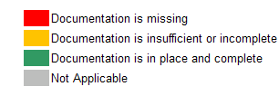
Graphical Analysis Heatmap Table
Region
Segment
NPA ID
TITLE
Proposer
Final
Treasury
Submission
Approval
TRADING
Risk
Credit
Accounts
IT
Legal
Desk
Operations
Controllers
Quants
Tax
Quorum Comments
Date
Date
Strategists: Comment should read
CANADA
SALES
NPA-2011-
Private
7-Feb-13
4-Apr-13
Fred
Jane
Dora
Janet Jacks
Raj Zitz
Dell Zanger
Gertrude
Noel Langlois
Meredith
John
Rob Fritz
not introduce any new features and will utilize
0056
Mattets Fund II
Flintstone
Maloney
L'explora
Huang
Obama
Doe
existing model(s) list all applicable models and
associated IDs."
ASIA
SALES
NPA-2011-
Morgan
8-Feb-13
31-May-13
Fred
Wes
Dora
Matt Cross
Katherine
Raj Zitz
Jason
Gertrude
Katie Shields
Meredith
John
Edwin Van
Strategists: missing details
0057
Equity IV L.P.
Flintstone
Henry
L'explora
Joe
King
Huang
Obama
Doe
CANADA
SALES
NPA-2011-
Multi-Asset Portfolio
13-Feb-13
14-May-13
Fred
Dan
Dora
Matt Cross
Janet Jacks
Raj Zitz
Edward
Gertrude
Paul
Meredith
John
Phil Rein
Strategists: No details. Comment not in line with
0068
Flintstone
Carroll
L'explora
Morey
Huang
Zuumba
Obama
Doe
policy.
CANADA
SALES
NPA-2011-
Emerging
13-Feb-13
14-May-13
Fred
Bill
Dora
Matt Cross
Janet Jacks
Raj Zitz
Edward
Gertrude
Paul
Meredith
John
Phil Rein
Strategists: No details. Comment not in line with
0069
External Debt Portfolio
Flintstone
Zizzy
L'explora
nMorey
Huang
Zuumba
Obama
Doe
policy; Compliance checklist uploaded 7/30/2011
CANADA
SALES
NPA-2011-
Emerging
13-Feb-13
31-May-13
Fred
Dan
Dora
Matt Cross
Janet Jacks
Raj Zitz
Mayy Mills
Gertrude
Paul
Meredith
John
Phil Rein
Strategists: No details. Comment not in line with
0070
Portfolio
Flintstone
Carroll
L'explora
Huang
Zuumba
Obama
Doe
policy;
CANADA
SALES
NPA-2011-
Shares to
14-Feb-13
30-Apr-13
Fred
Dan
Dora
Matt Cross
Janet Jacks
Raj Zitz
Daniel
Gertrude
Paul
Meredith
John
Phil Rein
Strategists: No details. Comment not in line with
0073
MSIFT Fund Families
Flintstone
Carroll
L'explora
BurtonBart
Huang
Zuumba
Obama
Doe
policy.
CONGO
SALES
NPA-2011-
MS Share Classes
22-Feb-13
9-May-13
Fred
Bob Woodl
Dora
John
Raj Zitz
CaryWall
Gertrude
Dave
Meredith
John
Phil Rein
Strategists: No details. Comment not in line with
0086
Flintstone
L'explora
Sell
Huang
Onny
Obama
Doe
policy;
CONGO
SALES
NPA-2011-
Private Equity Fund of One
15-May-13
13-Aug-13
Fred
Jane
Dora
Janet Jacks
Raj Zitz
Ken Zanger
Gertrude
Noel Lang
Meredith
John
Rob Fritz
Strategists: format does not follow strats
0119
Flintstone
Maloney
L'explora
Huang
Obama
Doe
procedures.
CONGO
SALES
NPA-2011-
MS Absolute Return
Fred
Bugs
Dora
Gertrude
Paul
Meredith
John
Strategists: No details. Comment not in line with
0199
Currency Class AH (SEK)
2-May-13
31-May-13
Flintstone
Moore
L'explora
Janet Jacks
Raj Zitz
Chris Dell
Huang
Zuumba
Obama
Doe
Rob Fritz
policy.
Compliance checklist uploaded 7/30/2011.
CANADA
SALES
NPA-2011-
International Small Cap
17-Sep-13
28-Sep-13
John
Sam
Dora
Janet Jacks
Raj Zitz
Stefanie
Gertrude
Dave
Meredith
John
Phil Rein
Strategists: Given documentation and comment
0389
Bush
Carroll
L'explora
Yellow
Huang
Onslow
Obama
Doe
should decision be opt out?
NPA-2011-
Portfolio of
John
Billy
Benoit
Andrew
Angela
Nicholas
Eleanor
John
Meredith
Roy
FCG: checklist looks different than usual. Is this
CANADA
TRADING
0305
listed derivatives
18-Jul-13
20-Sep-13
Bush
Curran
Diddy
Stratty
Levin
Zell
Willy
Van Menon
RatzesbergerRats
Lana DuFree
checklist acceptable?
and OTC's at CME
Obama
Holst
MRD: NPA details (name, number,, date,
decision, RC) not filled out.
CANADA
TRADING
NPA-2011-
Letters of Credit
26-Jul-13
11-Sep-13
John
Billy
Benoit
Andrew
Angela
Nicholas
Su Mamma
Van Menon
Darragh
Meredith
Homer
D’brave
Roy
MRD: SumMayy questions not answered, 2
0307
Bush
Curran
Diddy
Hill
Levas
Orly
DempseySmith
Obama
Holst
responses selected for Q17a.
7, 10, 18 inconsistent with MRD responses.
CANADA
IED
NPA-2011-
Technology JV
26-Apr-13
5-Jul-13
John
Bill Krause
Benoit
Stephanie
Mayty
Elle Smith
Joyce
David
Joel Joel
Meredith
Pankaj
Jay Klein
Tax: Q12 requires follow up.
0282
MMack
Diddy
Jones
O'Malley
Fread
Dreskin
Obama
Chatty
No answer to Q18.
CANADA
RETAIL
NPA-2011-
Foreign Program
21-May-13
20-Jul-13
Fred
Fred
Sadam
Steven
Husein
Sally
Dave
Chandler
John Clinton
Meredith
Cyrus
Roy
Legal: missing comment.
0075
Flintstone
Selby
Hussein
Michael
Ray
Kamath
Hughes
Philly
Obama
Mohan
Holst
CANADA
Corporate
NPA-2011-
Bank Treasury
17-May-13
7-Sep-13
John
Philip
Mayia
Cindy Smith
Justin Mruz
Gerard
Mayia
Chandler
John
Meredith
Dave
Roy
Credit: Comment on 99 is technically incorrect as
Treasury
0227
Currency Management
Bush
Roth
Benny
Hilltop
Orwell
Philly
Evie
Obama
Andre
Holst
this is not an MSBNA NPA.

Slide 79
Graphical Analysis
Stacked Area
1,200
<6M
6M-1Y
1-2Y
2-3Y
3-5Y
>5Y
1,000
Kappa (term buckets)
800
600
400
200
-
Dec-06
Mar-07
Jun-07
Sep-07

Slide 80
Graphical Analysis
Bubble
Quarterly Sharpe Ratios
12
(points scaled by average 95% VaR)
10
05Θ3
07Θ1
8
06Θ1
6
07Θ2
'Sharpe' Ratio
4
05Θ4
07Θ3
2
06Θ2
06Θ4
07Θ4
0
06Θ3
(2)
Quarter

Slide 81
Four Key Excel Functions
Spinner (VB control)
Vlookup( )
Index ( )
Data Table

Slide 82
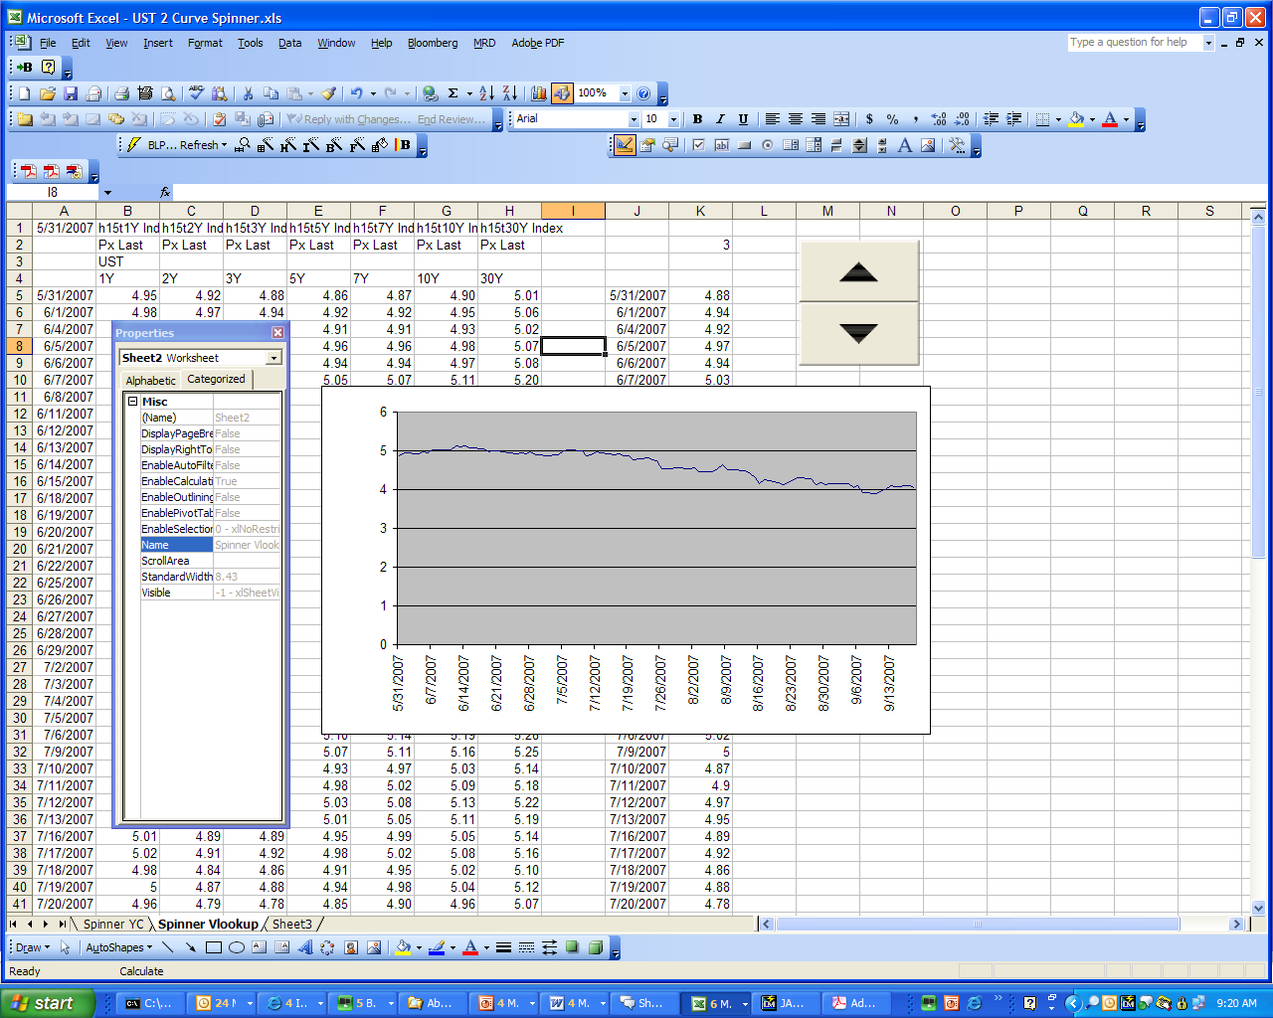
Spinner

Slide 83
Descriptive Statistics
Moments
Mean
Variance
Skewness
Kurtosis
Serial Correlation

Slide 84
Spinner
Useful for
Single YC
Time Series selection
Surface plots
Can be customized via VB or “Properties”
Don’t be scared by the VB!

Slide 85
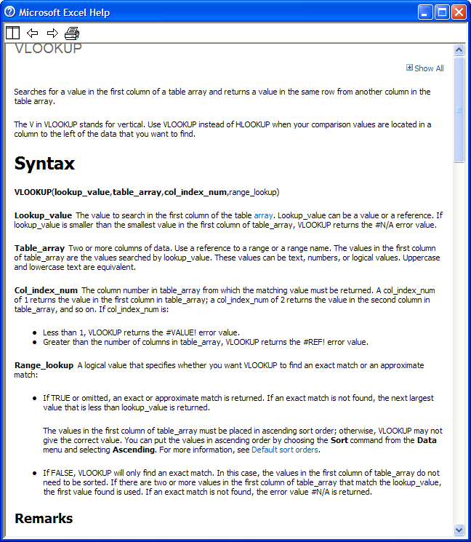
Vlookup( )

Slide 86
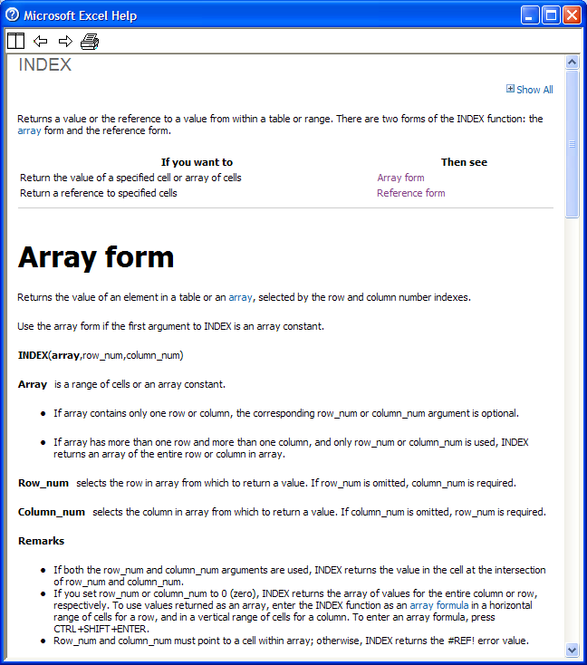
Index( )

Slide 87
Data Table
Possibly the most useful function in Excel
Underutilized
Misunderstood
Many applications
MC Simulation
Surface plots

Slide 88
Descriptive Statistics
Mean: =average()
What is the central tendency of the data?
Also: median, mode

Slide 89
Descriptive Statistics
Variance: =var()
What is the variable’s dispersion about its mean?
Question: Assume mean is zero?

Slide 90
Descriptive Statistics
Skewness: =skew()
Is the distribution symmetric?
Standard error = sqrt(6/n)
Usually not a big deal

Slide 91
Descriptive Statistics
Kurtosis: =kurt()
Does our data have fat tails (leptokurtosis)?
A big problem in financial time series
Standard error = sqrt(24/n)
Jarque-Bera: a simultaneous test of skewness and kurtosis

Slide 92
Descriptive Statistics
Serial Correlation: correl(r₁:r_{n},r₂:r_{n+1})
Is our data independent?
Positive, negative serial correlation
Another big problem with financial time series
standard error = sqrt(1/(n-1))

Slide 93
Descriptive Statistics
Tests for IID Normality
skewness
kurtosis
1st order serial correlation
JB
ADFURT
Chi-squared
More general: KS

Slide 94
Missing Data

Slide 95
Missing Data
Four basic approaches
Use prior day (fill forward)
Interpolation
Brownian Bridge
Regression-based (EM)
Can combine BB and EM

Slide 96
Overview
Simple Approaches
Interpolation
Use prior
Bootstrap
Brownian Bridge
Analytically pure
Brute Force
Regression-based (EM-lite)

Slide 97
Dealing With Missing Data
Lots of academic minutia available on this topic
Some firms try to keep vol constant as they fill in, others assume jumpiest price move to accent volatility
Some firms use the EM algorithm
Computationally intensive
Theoretically incorrect in a time-varying framework
intuitively onerous

Slide 98
Simple Approaches
Use average of day before and day after (interpolation)
easy to implement
maximum likelihood
dampens volatility
Use prior day
Easy
May increase volatility
Choice depends in part upon differencing interval

Slide 99
What is Bootstrap?
Bootstrap is a MC technique that involves random draws from an existing (usually historical) dataset
It is usually used to alleviate small sample problems
Within a MC framework, it is nonparametric – it makes no assumptions about the underlying distribution of the data

Slide 100
Why Bootstrap?
Again, small sample
Can’t afford to make assumptions about higher moments
Easy to explain
Easy to set up
Robust w.r.t. time series analysis

Slide 101
A Spreadsheet Approach to Bootstrap
First, get historical data
(Check for dirty data)
Difference the data
Index the data from 1…x
Determine length of path desired (say n)
For each time period in n, draw a random integer between 1 and x

Slide 102
Drawing Random Integers
Use the Rand() function in Excel
This draws a random uniform variable between 0 and 1
We scale this variable by multiplying it by x
Then, we need to extract only the integer portion: int(rand()*x)
BUT, we’re not done: we now have an integer between 0 and x-1
So, we need to add 1
i.e. int(rand()*x)+1 gives us what we need

Slide 103
Using the Random Integers
Insert one of the random integers for each point on the path
Use the vlookup() function to look up the integer value in the indexed historical differences
Generate the path
“gross up” the differences by adding one to each
Successively multiply the grossed up values by each other
Note either the final point or the key path dependencies

Slide 104
Example
Random Integer | Lookup of historical data | 1+X grossup | MC time series
 |  |  | Starting point X_{end}
N₁ | X_{n1} | (1+X_{n1}) | X_{end}*(1+X_{n1})
N₂ | X_{n2} | (1+X_{n2}) | X_{end}*(1+X_{n1})* (1+X_{n2})
N₃ | X_{n3} | (1+X_{n3}) | X_{end}*(1+X_{n1})* (1+X_{n2})*(1+X_{n3})
N₄ | X_{n4} | (1+X_{n4}) | X_{end}*(1+X_{n1})* (1+X_{n2})*(1+X_{n3})* (1+X_{n4})
N₅ | X_{n5} | (1+X_{n5}) | X_{end}*(1+X_{n1})* (1+X_{n2})*(1+X_{n3})* (1+X_{n4})*(1+X_{n5})
N₆ | X_{n6} | (1+X_{n6}) | X_{end}*(1+X_{n1})* (1+X_{n2})*(1+X_{n3})* (1+X_{n4})*(1+X_{n5})* (1+X_{n6})

Slide 105
What Now?
We now have a path.
We can either
Generate P&L at each point
Test to see if triggers and/or barriers are hit
Examine ending value
You should graph the path
Gain intuition
Error check

Slide 106
Common Applications
Principal protected products
Time series analysis
VaR
10 day var
Other short-term paths e.g.
10*1
1-2-2-5
5*2

Slide 107
Interesting Variants
“Biasing” the history
Introducing drift
Drawing pairs

Slide 108
Brownian Bridge
Why Brownian Bridge?
Missing data
Convert data frequency
Primary Issues
Maintenance of volatility
Maintenance of audit trail
Correlation with other indices

Slide 109
Brownian Bridge: The Basic Idea
“connect the dots” in such a way that
Periodic vol is consistent
Each end point is “hit”
OR
You create a stand-alone, uncorrelated series

Slide 110
Brownian Bridge: The Basic Idea
Two basic approaches
“closed form”
Self-contained
More computationally intensive
More rigorous
Less intuitive
GRW with drift adjustment
Can be correlated with other time series
Possible noise with drift adjustment
A bit less scientific
MUCH more intuitive

Slide 111
How It Works:
Sequence of prices:

Slide 112
How It Works:
joint p.d.f. of
we observe
What is the conditional p.d.f. of
given the observed value of
?

Slide 113
How It Works:

Slide 114
How It Works:
Conditional Distribution Theorem: If x (an n-dimensional vector) and y (an m-dimensional vector) are joint normally distributed:
then the distribution of x conditional on y is:

Slide 115
How It Works:
For the purposes of this analysis

Slide 116
Footnote
* Based upon calculations in Garbade, Kenneth, “Variable Coefficient Estimation, Bankers Trust Company, March 1994, pp. 24-39 and working papers based thereupon.

Slide 117
Another Approach:
Freight Time Charter Bridge-
Correlated Multivariate Brownian Bridge
Notes:
2

Slide 118
Raw Data
Raw historical data proves inappropriate for a one-day VaR, with infrequent marking resulting in a disproportionate number of 0% daily returns and in non-zero returns that are overly volatile.
Our goal, therefore, is to translate what information we do have into price series appropriate for one-day VaR.
Because on a daily basis, Wet Freight Time Charter prices are typically not well correlated with other time-series, an attempt at a regression-based in-fill would lack the necessary right-hand variables.
The pieces of information we have are 1) a skeleton of price levels, and 2) the observed variance-covariance matrix (of %returns) across the Charters. Using the latter, we will apply a Brownian Bridge to the former that ultimately maintains correlation and volatility.
Notes:
2

Slide 119
Step 1. Price Skeleton
Step 1 is to identify the skeleton of prices that will be the dots that the bridge will connect.
In this instance, we define the skeleton as the prices of all series on each date that any series’ price changes. (Note that while only VLCC is shown, all other series are relevant in determining the skeleton of VLCC.)
Notes:
2

Slide 120
Step 2: Random Correlated Returns
Step 2 is to generate random (i.e. Brownian) normals and matrix multiply by the Cholesky Decomposition of the observed variance-covariance matrix, thereby imposing the observed correlation and volatility on the bridge. The product is our random correlated returns with which we will use to bridge the prices.
Random Correlated Returns = A · B
where A ~ N(0,1)
where B = chol( cov( ) )
Notes:
2

Slide 121
Step 3: Adjusted Bridging
Step 3 is to bridge the price data using the random correlated returns – only, the random correlated returns must first be adjusted.
For example, we start out with two skeleton prices to be bridge…
Notes:
2

Slide 122
Step 3: Adjusted Bridging
… And when we use our random correlated returns, the implied price path does not connect the dots (in the table below, the blue cells are the targets, whereas the red cells are the random results)…
Notes:
2

Slide 123
Step 3: Adjusted Bridging
… This path has an implied relative axis (implied by the slope between it’s starting and ending points), around which the path is oriented…
Notes:
2

Slide 124
Step 3: Adjusted Bridging
… Effectively what the adjustment does is to rotate this relative axis to the slope between the skeleton prices…
Notes:
2

Slide 125
Step 3: Adjusted Bridging
… For each leg of the bridge f, i.e. each pair of skeleton prices P, an adjustment a is calculated such that the following equality is met, where r are the random correlated returns, t is time, and n is the length of the bridge in days:
Notes:
2

Slide 126
Step 3: Adjusted Bridging
… The adjustment results in a bridge that successfully connects the dots. In the table below, the yellow cells match the targeted blue cells.
Notes:
2

Slide 127
Final Results
The final result is a Brownian Bridge that maintains the skeleton of the original prices…
Notes:
2

Slide 128
SIMPLE BROWNIAN BRIDGE
Get % changes on available data, measure variance, get stdev.
Generate random normals for missing data by calibrating std normals
by the stdev you just measured. Fill in missing % changes w random
normals. Backfill levels with what filled changes imply (green), measure
gap (height of blue arrow). Go back to random normals and ADD TO
EACH ONE the height of the blue arrow, divided by the number of miss-
ing +1. That is the DRIFT. It will ROTATE the green line.
Need to estimate this

Slide 129
Final Results
… and maintains covariance. As the statistics in the accompanying table illustrate, the correlation matrix and the standard deviations are maintained. As expected, the bridging affects tails as well as the third and fourth moments of the distributions.
Notes:
2

Slide 130
Regression-based Infill
Kind of EM-lite
Take data you do have and use it to estimate data you don’t have
Useful if you have correlated data

Slide 131
Raw
data
% Changes
“shrunken”
data
% Changes
w estimated
Missing data
A
A
Regress rightmost
column of shrunken dataset
on other columns, use regression to estimate missing data, B’
A
Now, regress rightmost
column of “reconstituted” dataset on other columns, use new regression to re estimate missing data, B’, now including the previously estimated data.
B
C
B
B’
C
C
MISSING
DATA
RIGHT
COLUMN
% Changes
w RE-estimated
Missing data
SIMPLE EM EXAMPLE
A
Repeat until convergence.
B
B’’
C

Slide 132
Methodology

Slide 133
Different Methodologies
Example of one-asset VaR
Price-based instruments
Yield-based instruments
Variance/Covariance
Monte Carlo Simulation
Historical Simulation

Slide 134
Variables in the methods
Interest rate sensitivity – duration, PV01,
Equity exposure
Commodity exposure
Credit – spread duration
Distribution/Linearity of price behavior
Regularity of cash flow/prepayment
Correlation across sectors and classes

Slide 135
Methodology: What Are We Trying to Calculate?
0.50
0.45
0.40
0.35
0.30
0.25
0.20
0.15
0.10
0.05
0.00
−4.00
−3.50
−3.00
−2.50
−2.00
−1.50
−1.00
−0.50
0.00
0.50
1.00
1.50
2.00
2.50
3.00
3.50
4.00
We want to estimate the worst 1% of the possible outcomes.

Slide 136
Methodology: VaR Concepts
Date IPC
01/02/95 2354.24
01/03/95 2278.47
01/04/95 2261.73
01/05/95 2273.1
* *
* *
* *
12/25/96 3298.47
12/26/96 3310.89
12/27/96 3327.2
12/30/96 3346.95
12/31/96 3361.03
Consider one time series, the Mexican
IPC stock index, for example:
IPC
3900
3400
2900
2400
1900
1400
01/02/95
07/03/95
01/01/96
07/01/96
12/30/96
We want to know how much this market could possibly move against us, so we know how much capital we need to support the position .

Slide 137
Methodology: Why We Use Returns
Most financial time series follow random walks, which means, among other things, that the best estimate of tomorrow’s value is today’s value.
Since random walks are not bounded, predicting the future path is difficult if we focus only on the levels.
A frequency distribution of IPC levels from 1995-1996 illustrates the difficulty:
Frequency Distribution of IPC Levels: 1995-1996
80
70
60
50
40
30
20
10
0
1400
1600
1800
2000
2200
2400
2600
2800
3000
3200
3400

Slide 138
Methodology: Why We Use Returns
Consider the returns of the IPC over the same period, where returns are defined as the percentage change in the index:
180
160
140
120
100
80
60
40
20
0
−6%
−4%
−2%
0%
2%
4%
6%
8%
10%
Here, the frequency distribution falls into a familiar pattern.

Slide 139
Methodology: Estimating Volatility
Once we have a time series of returns, we can gauge their relative dispersion with a measure called variance.
Variance is calculated by subtracting the average return from each individual return, squaring that figure, summing the squares across all observations, and dividing the sum by the number of observations.
The square root of the variance, called the standard deviation or the volatility, can be used to estimate risk.
In a normal distribution, 2.33 * the standard deviation represents the largest possible movement 99% of the time (1.64 * the standard deviation for 95%).

Slide 140
Methodology: Estimating Volatility
Mathematically, variance is:
The standard deviation is the square root of this term.
The Excel functions for these two are var() and stdev()

Slide 141
Methodology: Using Volatility to Estimate Value at Risk
The variance of the daily IPC returns between 1/95 and 12/96 was 0.000324
The standard deviation was 0.018012 or 1.8012%
2.33 * 1.8012% = 0.041968 or 4.1968%
We can conclude that we could expect to lose no more than 4.1968% of the value of our position, 99% of the time.

Slide 142
Methodology: Using Volatility to Estimate Value at Risk
This means that an investment in the IPC of MXP 100 investment would suffer daily losses over MXP 4.2 only about 1% of the time.
In fact, the IPC lost more than 4.2% 8 times since 1/1/95, or about 1.5% of the time.
While this figure is approximately accurate, it illustrates a problem VaR has in certain markets, that it occasionally underestimates the number of large market moves.
This problem, while frequent at the security or desk level, usually disappears at the portfolio level.

Slide 143
Methodology: Review of One Asset VaR
Collect price data
Create return series
Estimate variance of return series
Take square root of variance to get volatility (standard deviation )
Multiply volatility by 2.33 by position size to get estimate of 99% worst case loss.

Slide 144
Methodology: Caveats
Longs vs. Shorts: sign is important
simple for equities
requires thought for FX
One-sided vs. two-sided confidence intervals
Bad data
Percentage changes vs. log changes

Slide 145
Methodology: Fixed Income
Fixed income instruments require an adjustment to this method.
This is because time series generally available for fixed income securities are yield series, while we are concerned with price behavior.
The adjustment requires expressing the volatility in of basis points and the position in terms of sensitivity to a 1 basis point movement in yields.

Slide 146
Bond Pricing: A Digression
A bond is an annuity and a bullet payment
An annuity is a perpetuity minus the future value of a perpetuity
The function of price wrt yield is nonlinear
With P on the Y axis, this function is convex wrt the origin.

Slide 147
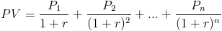
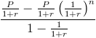
How is the PV of Annuity Formula derived?
The present value of a series of payments, whether the payments are the same or not, is:
When the periodic payments or dividends are all the same, this is considered a geometric series. By using the geometric series formula, the formula can be rewritten as
http://www.financeformulas.net/Present_Value_of_Annuity.html

Slide 148
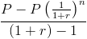
How is the PV of Annuity Formula derived?
This equation can be simplified by multiplying it by (1+r)/(1+r), which is to multiply it by 1.
Notice that (1+r) is canceled out throughout the equation by doing this.
The formula is now reduced to
The P's in the numerator can be factored out of the fraction and become 1.
The 1's in the denominator of the formula are subtracted from one another.

Slide 149
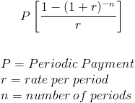
How is the PV of Annuity Formula derived?
After making these adjustments, the formula is simplified to the present value of annuity formula

Slide 150
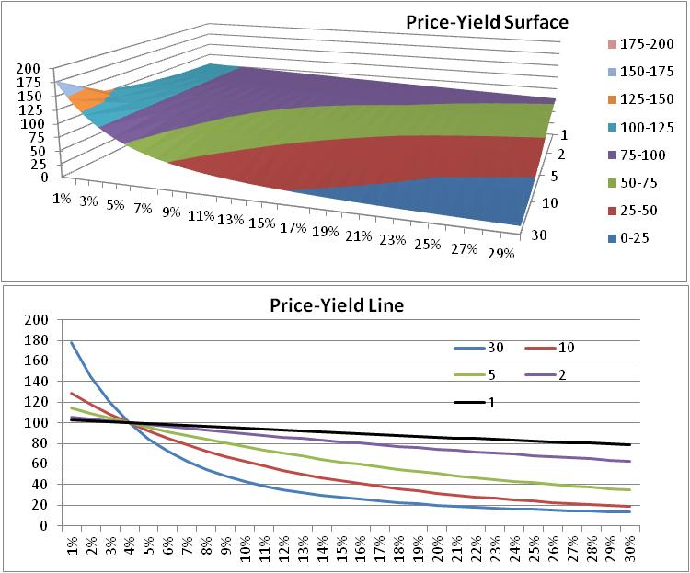
Price-Yield Relationship

Slide 151
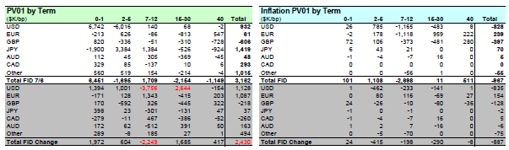
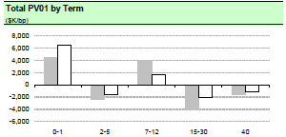
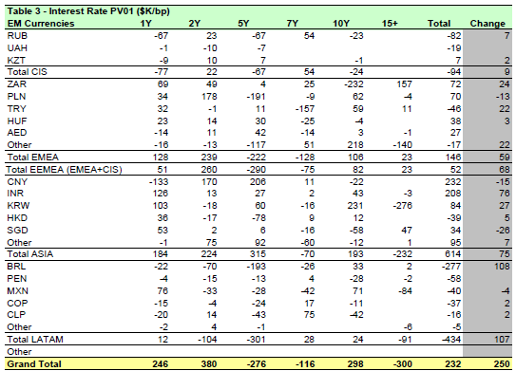
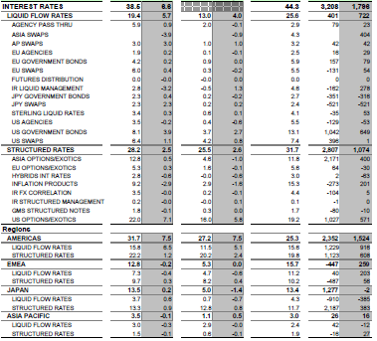
IR Risk Reporting

Slide 152
Methodology: Fixed Income
Equities, Foreign Exchange, Commodities:
position * σ_{price} * 2.33 (or 1.64 for 95%)
}
Fixed Income:
position * PV01 * close * σ_{yield} * 2.33 *100
}
position sensitivity to a one BP movement in yields
potential movement in
yields measured in BP

Slide 153
Methodology: Fixed Income Example
Consider a USD 100 position in 10 year UST:
Vol of the percentage changes in UST yields since 1/1/03 = 1.312%
DV01 = change in price at 12/31/96 yield if yields were to increase by 1 basis point
(Duration may also be used here)

Slide 154
Methodology: Fixed Income Example
Price at yield of 4.644% = 100
Price at yield of 4.654% = 99.92077
DV01 = 99.920765-100 = 0.07923 per $100
This sensitivity changes with the level of yields, but provides a good approximation

Slide 155
Methodology: Duration vs. DV01
Duration measures the weighted average time to a security’s cash flows, where the weighting is the cash flow.
Duration also shows the percentage change in price per change in yield.
DV01 provides a similar measure, but often per 1 million of face value.
Bond traders think in DV01’s; portfolio managers think in terms of duration.
Either measure is effective but BE CAREFUL OF THE UNITS. This is one of the easiest errors to make!

Slide 156
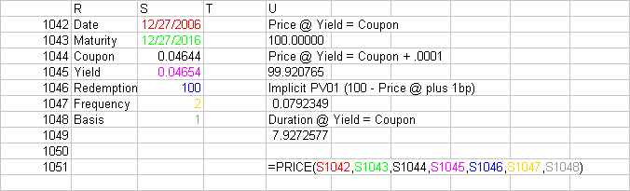
Methodology: Duration & DV01 Examples
UST Example:
Use Excel PRICE( ) function
Remember to divide coupon/yield by 100 (4.644% = .0644)
Assume redemption at par
Note similarity of PV01 to Duration
Basis | Day count basis
0 or omitted | US (NASD) 30/360
1 | Actual/actual
2 | Actual/360
3 | Actual/365
4 | European 30/360

Slide 157
Spread PV01
For credit-risky securities, we should distinguish between interest rate risk and credit risk
The credit spread takes default (and recovery) into consideration
We usually consider these separately
Often, we assume PV01=CSPV01
If recovery=0, then this is true
Otherwise, it is not
There are different sources for spreads
Calculated
CDS
Asset swap spreads

Slide 158
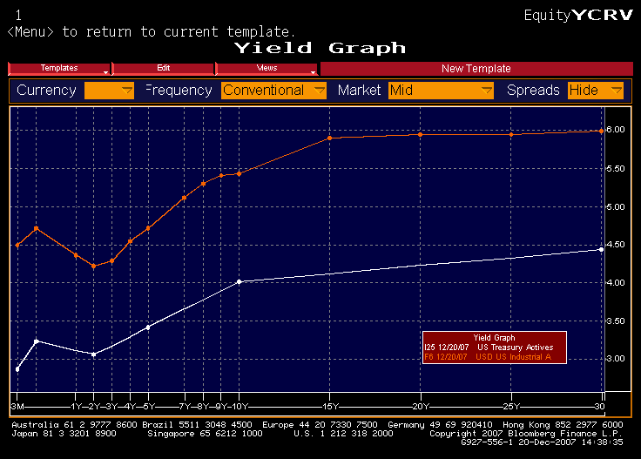
Spread PV01
Credit Spread
Risk-Free
Rate

Slide 159
Required Reading
Garbade papers
First 3 chapters of the MS Fixed Income Book
PIMCO deck
PCA Paper
Returns vs Differences Paper (more on this later…)

Slide 160
Methodology: Putting It All Together
Position details:
Size: USD 100
Maturity: 10 Years
Vol: 0.01312
DV01: -.07923 (per 100)
12/27/06 Close = 4.644%
VaR = -.07923*0.04644*.01312*2.33*100
= 1.12479

Slide 161
Methodology: Adding Additional Assets
The notion of covariance allows us to consider the way assets’ prices behave with respect to each other.
Technically:

Slide 162
Methodology: Covariance
What does this mean?
It gives an indication of how far one variable is from its mean when we observe another variable a certain distance from its mean.
In other words, it says how much (and in which direction) y moves when x moves.
It provides a measure for every variable with respect to every other variable.

Slide 163
Methodology: Portfolios
Some Basic Statistical Principles:
variance(a+b)=variance(a)+variance(b)+2*covariance (a,b)

Slide 164
Methodology: Covariance
Why is this important?
If we know the variances and covariances of all of the securities in a portfolio, we can assess the risk of the entire portfolio.
We can also assess the risk of any subportfolio.
This is the basis of much of modern portfolio theory.

Slide 165
Methodology: Correlation
How is correlation different from covariance?
we can scale covariance to get correlation:
covariance is not unit free
correlation is an index of linearity

Slide 166
Methodology: Correlation
Does it matter which one we use?
As long as we adjust for units, no.
Why use one or the other?
intuition is easier for correlation
calculations are easier with covariance
If we know covariances, we also know the correlations, but NOT vice-versa.

Slide 167
Methodology: More Facts
So far, we have examined portfolios with only one “unit” of each asset.
Most portfolios hold several shares, several bonds, or several contracts.
variance of (xa) where x is units (shares, contracts, bonds)=x² var(a)
variance of (xa+yb)=x² var(a)+y² var(b)+2xycov(ab)

Slide 168
More Facts (continued)
This can be extended:
var(a+b+c)=var(a)+var(b)+var(c) +2cov(ab)+2cov(ac)+2cov(bc)
var(xa+yb+zc)= x²var(a)+y²var(b)+z²var(c) +2xy cov(ab)+2xz cov(ac)+2yz cov(bc)
var(a+b+c+d)=var(a)+var(b)+var(c)+var(d) +2cov(ab)+2cov(ac)+2cov(ad)+2cov(bc)+2cov(bd)
+2cov(cd)
d) var(xa+yb+zc+wd)=x²var(a)+y²var(b)+z²var(c)+ w²var(d)+2xy cov(ab)+2xz cov(ac)+2xwcov(ad)+ 2yz cov(bc)+2yw cov(bd)+2zw cov(cd)

Slide 169
Simplifying the Arithmetic
Obviously, this gets messy, very fast.
If we are to extend this to portfolios containing many assets, we need to find a way to simplify the calculations.
To do this we need two new concepts, one simple and one fairly complicated.
Covariance and Correlation matrices
Using linear (matrix) algebra

Slide 170
Covariance/Correlation Matrices

Slide 171
Covariance Matrices
Notice that if we sum
the items in the matrix
we end up with the
sum of the variances
+ 2 x the sum of the
covariances.
We can use this to our
advantage.

Slide 172
Covariance Matrices
If a portfolio has one unit of each security whose prices are tracked in the covariance matrix, the portfolio variance is the sum of the items in the covariance matrix.
This rarely happens in the real world.
We have to find a way to deal with this.

Slide 173
Correlation, Covariance & Time
The one-day time frame makes using correlation matrices less theoretically ambiguous
Question of correlation stability over time
Correlations tend to “swing” from neutral to directional when markets under stress
Short time frames mean linear approximations less problematic

Slide 174
Using Matrix Algebra
Matrix (linear) algebra is used to summarize arithmetic calculations involving rows and columns of figures.
It can be thought of as arithmetic shorthand.
It is easily performed in spreadsheets using the MMULT() and TRANSPOSE() functions.

Slide 175
Using Matrix Algebra
A course in linear algebra is well beyond the scope of this training program,
However, what you need to know to do variance/covariance analysis is relatively simple.
It requires only the MMULT() and TRANSPOSE() functions.

Slide 176
Using Matrix Algebra
Assume we have ($100) in CAD/USD, a ($50) in CHF/USD and ($25) in DEM/USD.
We arrange our spreadsheet like this:
By doing this we simultaneously perform all of the arithmetic described earlier.

Slide 177
Using Matrix Algebra
Several things to remember:
Must use Ctrl-Shift-Enter to enter matrix functions instead of just enter
number of positions must equal number of rows and columns in matrix

Slide 178
Interpreting the Results
The Excel function generates the variance. We must take its square root to get the standard deviation (volatility). Once we have the portfolio standard deviation, we multiply it by 2.33 to get the 99% value at risk.

Slide 179
The Big Picture
Elements for Variance/Covariance calculations
data collection
the calculation of returns
data testing
matrix construction
positions and position vectors
matrix multiplication
capital calculation
interpretation

Slide 180
Flow Diagram
Variance/Covariance Analysis
Source 1
1
2
3
4
Source 2
Market
Tests:
Market
Source 3
Data
Returns
1. Graphs
Covariance
2. 2 std
Matrix
∑
Source 4
5
6
7
Position
Position
Matrix
Data
Vector (in-
Multiplication:
cludes DV01's)
X'
ΣX
8
9
10
11
Portfolio
Absolute
Marginal
Scenario
VaR
Sub-Portfolio
Sub-Portfolio
Analysis
VaR
VaR

Slide 181
Assumptions
Getting Data
Time period
Weighting
Bucketing
uncorrelated assets
related assets
Gaps in Data
Updating frequency
Intervals for differences

Slide 182
Getting Data
Price & security data sources
DRI (Fame)
Datastream
WWW
Bloomberg
Internal
Covariance matrix sources
Riskmetrics
Bloomberg
Credit info
Creditgrades/Riskmetrics
KMV
Ratings Agencies
Bloomberg

Slide 183
Time Period Coverage
How far to go back
Data availability
Change in pricing regimes
2008 Crisis
Brazil in 1995
Introduction of the Euro
Existence of market anomalies
Possible for traders to take advantage

Slide 184
Exponential Weighting
Different Weighting Schemes
Unweighted
Exponential

Slide 185
Exponential Weighting
The choice of a weighting coefficient has major implications
can be more difficult to implement
more difficult to check
can have a major effect on variances and covariances
in many ways, rather arbitrary
However can smooth vol as positions age
Acts in accordance with heuristic decision theory

Slide 186
Exponential Weighting
weights more recent observations more heavily, declines exponentially
need to estimate ω (weighting factor)
equation for covariance usually of form:

Slide 187
Exponential Weighting
VOLATILITY ANALYSIS
20%
15%
10%
5%
0%
−5%
01/1/92
07/2/92
01/1/93
07/5/93
01/4/94
07/6/94
01/5/95
07/7/95
01/8/96
% CHANGES
6M ROLL
0.94
0.96
0.98
0.92

Slide 188
Bucketing
We can't have a bucket for every position
To accommodate this, we "bucket"
By doing this, we reduce "granularity"
If we do it right, it causes no decrease in accuracy
Sometimes, we have to bucket the "uncorrelated assets" with a certain vol

Slide 189
Updating Frequency
Daily vs. Weekly vs. Monthly
Really a question of your assumptions about the markets
How often do things move?
changes in vol common in s/t eurodeposits and Japanese rates
changes in correlation structure difficult to estimate

Slide 190
Percentage Changes vs. Log Changes
The decision about which one to use is based primarily upon computational convenience.
The only real problem with using percentage changes is that it theoretically allows rates and prices to become negative.

Slide 191
Differencing Interval
Daily vs. Weekly vs. Monthly
What data is available?
Is the matrix used for trading or positioning?
Can it be scaled up or down?
technically yes, but...
asynchronicity issues
serial correlation issues

Slide 192
Technical Issues
Units
Are positions recorded in millions?
Are FX positions recorded consistently?
same base currency
correct sign (long or short base currency)
Fixed Income sign

Slide 193
Incorporating Fixed Income
The previous example assumed that the positions were either FX, commodity of equity positions.
For these types of assets we measure prices.
The positions size x the largest price move expected (2.33 x standard deviation) directly tells us our expected worst loss.
In fixed income markets, we measure yields .

Slide 194
Incorporating Fixed Income
To include fixed income positions, we must multiply the position by something to reflect their price sensitivity to yield changes.
This is done through the use of DV01 (value of a basis point) or duration in the manner described earlier.
The adjustment should be made in the position vector.

Slide 195
Absolute VaR
What is the absolute VaR of each bucket?
Two ways to calculate
take individual position sensitivity and multiply by position vol (not variance)
use position vector, but successively zero out all positions but the one of interest

Slide 196
Marginal VaR
Why?
Primarily to see how an individual position contributes to portfolio VaR
Illuminates natural hedges
Shows efficacy of hedge portfolios

Slide 197
Simulation Techniques

Slide 198
Two Basic Approaches
Historical Simulation
Historical simulation simply marks the portfolio to market using the rates/prices observed over certain historical period
These P&L figures are then ranked and the order statistic derived by taking the n^{th} worst outcome
n is a function of significance (usually 1%) and how much data is available
Monte Carlo Simulation
Simulation method using sequences of random numbers to approximate values which cannot be determined analytically
Phrase coined in Manhattan project due to similarity to games of chance
Only requirement is that system be describable in terms of p.d.f.’s

Slide 199
Simulation Overview
MC
Returns
Hypothetical
P&L
Desks
1 2 3
Total
P&L
HS
1/1/99
1/2/99
1/3/99
.
.
.
.
.
.
.
.
.
.
.
.
.
.
.
.
.
.
.
.
.
.
.
.
.
.
.
9/30/00
1
2
3
.
.
.
.
.
.
.
.
.
.
.
.
.
.
.
.
.
.
.
.
.
.
.
.
.
.
.
n
x position
size =
Σ
What is n?
obs n
1 year 250 avg(2&3)
2 years 500 5
3 years 750 avg(7&8)
4 years 1000 10
n^{th} worst
= Desk VaR
n^{th} worst
= Total VaR

Slide 200
Historical Simulation
Strengths:
Simple
Intuitively appealing
Nonparametric
Aggregation easy
Weaknesses
Need lots of data for good sample
May need historical data for things for which there is little history
How do you assume new products would behave?
Assumes stationarity

Slide 201
Performing HS
What are we really doing?
Can be thought of as limited Monte Carlo
same general idea & process architecture
nonparametric
Back testing current portfolio

Slide 202
Steps
Collect position data
Bucket to risk indices
Calculate sensitivities (and deltas, gammas)
Collect historical data
Calculate returns
"Shock" portfolio with returns data
Calculate P&L figures
Rank P&L figures and get order statistic

Slide 203
Calculate Sensitivities
For equities, FX, commodities, very easy
For fixed income: pos*DV01*close*100
Convexity not a big problem
For options, delta or delta & gamma
for daily VaR, delta is probably OK
need gamma for long holding period
may need for volatile markets

Slide 204
Collect Historical Data & Calculate Returns
Collect data
Sources
Problems
Missing data
Choice of time period
Frequency
Calculate Returns
% change or log change

Slide 205
Shock Portfolio & Calculate P&L
Now that we have sensitivities and shocks, we can generate the daily P&L numbers
These numbers have some noise built in due to convexity and gamma
These figures represent the hypothetical P&L from holding this portfolio over the last n days

Slide 206
Rank P&L
Simply sort the P&L figures
Take nth worst for order statistic
Probably makes sense to take 1%, 5% and 10%
depends upon numbers of observations
Important to save detail
P&L can be driven by very few actual positions

Slide 207
Now What?
VaR numbers in isolation are worthless
Need to calculate daily and compare
Issues
use actual P&L or actual changes in indices
repricing vs. sensitivities
Should be used in conjunction with Stress Testing and Scenario Analysis

Slide 208
Data Flow
Back Office
Systems
Positions/
Sensitivities
Historical
Data
Data
Providers
Determining
Possible
Outcomes
Limits
Reports
Stress
Tests
1% Worst:
VaR
Historical
Scenarios
Ad-Hoc
Analyses

Slide 209
Advantages of an Empirical Approach
Intuitive appeal
Ease of error checking
Credit spread activity “built-in”
No maintained hypothesis of multivariate normality
Automatic scenario analysis

Slide 210
Description of Monte Carlo
Simulation method using sequences of random numbers to approximate values which cannot be determined analytically
Phrase coined in Manhattan project due to similarity to games of chance
Only requirement is that system be describable in terms of p.d.f.’s

Slide 211
Financial Applications
Path-dependent products
Credit exposure
VAR

Slide 212
The Monte Carlo Process
Source 1
Source 2
Market
Data
Percentage
Changes
Tests:
1. Graphs
2. 2 std
Market
Covariance
Matrix
Source 3
∑
Source 4
broken down into
Random
Uniform
Variables
Box Mueller
Random
Normal
Variables
multiplied by
Eigensystem
Decomposition
to form
Correlated
Random
Variables
Repricing
P&L
Calculation
Order Statistic
VAR

Slide 213
The Monte Carlo Process
Seven basic steps
Random uniform number generation
Random normal conversion
Covariance matrix generation
Covariance matrix factorization
Creation of correlated random “shock” variables
Use of shocks for repricing
Estimating the VAR

Slide 214
The Monte Carlo Process: Random Uniform Number Generation
Three types of random numbers
truly random numbers
cannot be produced by computers
must be from external source like radioactive decay
Quasi-random numbers
difficult to implement
optimize uniformity
Pseudo-random numbers
generated by computer algorithm
look independent and uniform
prevailing method
many algorithms available, see Knuth

Slide 215
The Monte Carlo Process: Conversion to Random Normal
Essentially, one needs to take a uniform 0,1 and convert to a normal 0,1 by mapping the the uniform draws to the CDF of the standard normal curve:
1
1
0.9
0.8
0.7
0.6
0.5
0.4
0.3
0.2
0.1
0
0
-5 STD
+5 STD
see Box-Mueller method in Numerical Recipes in C

Slide 216
The Monte Carlo Process: Covariance Matrix Construction
Buy or Build
coverage
assumptions
missing data
weighting
Differencing Interval
daily vs. weekly vs. monthly
scalability

Slide 217
The Monte Carlo Process: Matrix Factoring
Goal: to get a “square root” matrix
Computationally, the most complex part of Monte Carlo simulation
Details given in Numerical Recipes in C

Slide 218
The Monte Carlo Process: Matrix Factoring
Two Methods
Cholesky
computationally simpler
used by several packages
requires positive definite matrix
create lower triangular such that Σ = LL’
Eigenvalue-Eigenvector decomposition
more complex
more robust
create E and Λ such that Σ = EΛE’

Slide 219
The Monte Carlo Process: Creating Correlated Shocks
If R is an n x 1 random normal vector Λ^{1/2} is an
n x n diagonal matrix containing the square roots
of the Eigenvalues and E is a matrix of the
Eigenvectors, then
RΛ^{1/2} E’~N(0,Σ)

Slide 220
The Monte Carlo Process: Creating Correlated Shocks
Checking the process
It is difficult to make small mistakes
Ways to check the factoring and the random correlated variables
re-creation of covariance matrix
test the variances with F or chi-squared tests
σ_{o}² /σ² ~F(m-1,k-1)
test the correlations with z-tests
ρ~N(ρ_{ο},(1-ρ_{ο}²)/n)
Box’s M test

Slide 221
The Monte Carlo Process: Creating Correlated Shocks
Potential Problems
precision
negative eigenvalues
computation time
data storage
error audit trail

Slide 222
Weaknesses
Assumption of multivariate normality
serial correlation
skewness
kurtosis
Must adjust to simulate mean reversion
Must adjust to simulate jump diffusion

Slide 223
Using the Shocks for Repricing
Now what?
Two basic approaches
Exact repricing
More exact
computationally burdensome
Parametric representation
can be very accurate
cross-partials can create some noise

Slide 224
Estimating the VAR
Once you reprice, calculate P&L
Order P&L results
Take nth largest case to get VAR
Need to group and sort to get subportfolio VAR

Slide 225
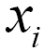
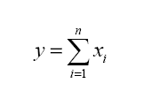
Marginal VaR
VaR engine produces pnl vectors with 1043 pnl dates each (4 year history)
For a given day, a parent pnl vector is sum of its child pnl vectors
e.g. Firm pnl = IED pnl + FID pnl
If y is the parent (eg. FIRM) pnl vector and are the children pnl vectors (eg. IED and FID)

Slide 226
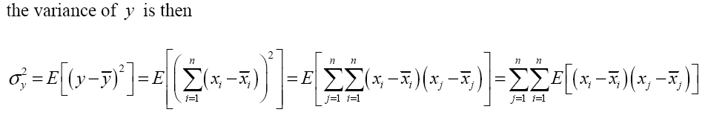
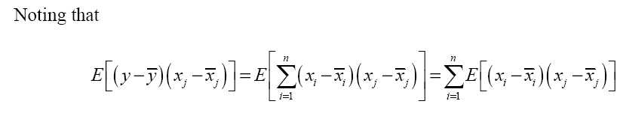
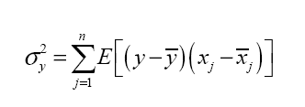
Variance and Covariance of Pnl Vectors
Lets consider variance as a proxy for risks associated with pnl vectors

Slide 227
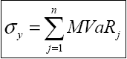
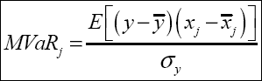
Define Marginal as Variance/Covariance Ratio
Lets rewrite this expression as
where

Slide 228
Marginal VaR using Variance/Covariance Ratio
We can use the variance/covariance ratio derived before to distribute Parent level VaR into marginals for Children
Covariance (Parent , Child)
i.e. Marginal VaR for Child = ------------------------------- * Parent VaR
Variance (Parent)
Covariance (Parent , FID)
And Marginal VaR for FID = ------------------------------- * Parent VaR
Variance (Parent)
Hence, Parent VaR = Child Marginal VaR + FID Marginal VaR

Slide 229
Marginal VaR using Variance/Covariance Ratio
Firm VaR and its marginals
Marginals are relative to the immediate parent in the hierarchy.
Marginals for all children always adds up to it Parent Standalone VaR

Slide 230
Using the Shocks for Repricing

Slide 231
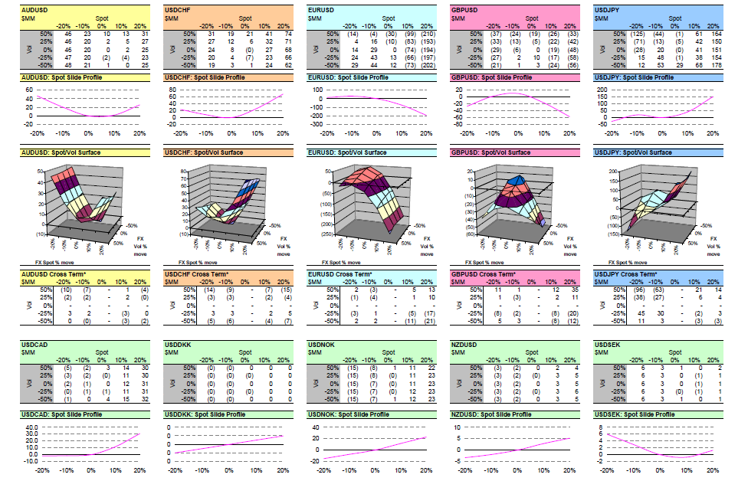
Pricing Grids

Slide 232
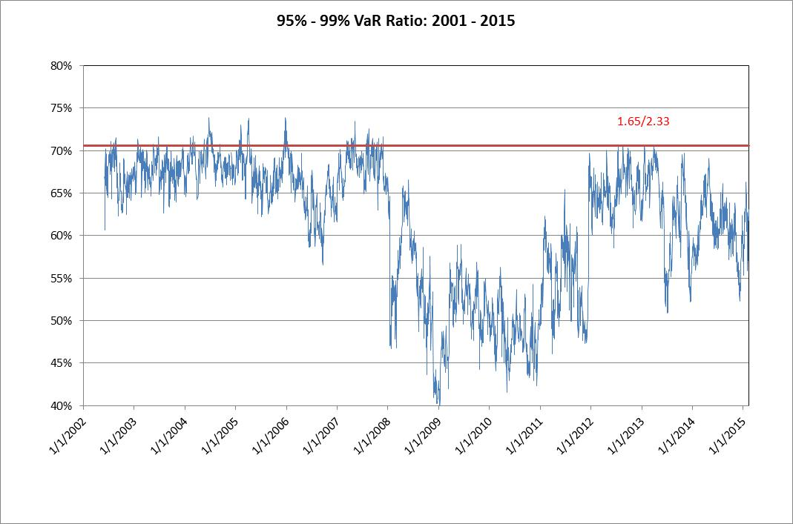

Slide 233
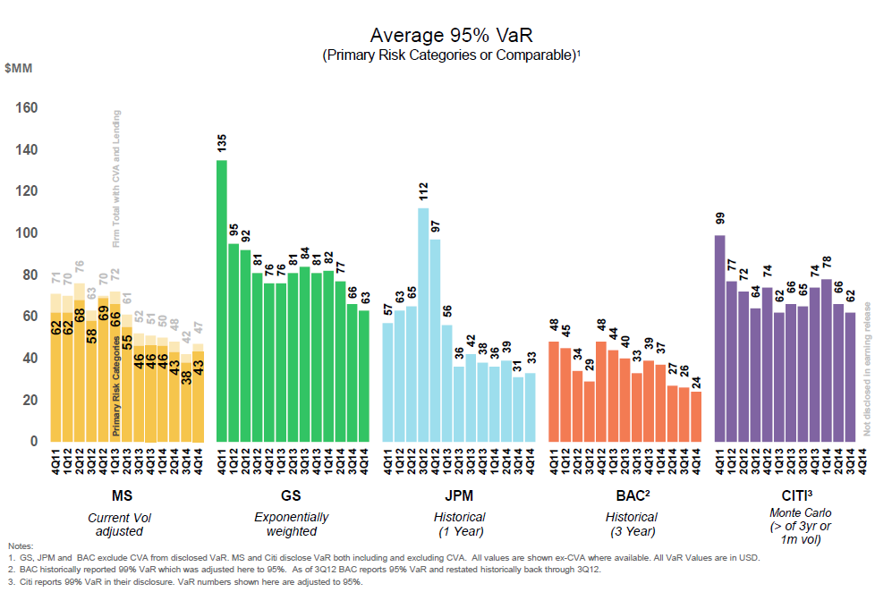
Competitive Comparison

Slide 234
Credit Loss Monte Carlo

Slide 235
Overview
Definition of Credit Risk
Review of the process
Issues surrounding correlation

Slide 236
Traditional Credit Analysis
based upon ratios, cash flow, industry analysis, collateral, intangibles
used to get a “yes” or “no” / crude limit
use financial statement info to calculate various indicators of default
focus on ratios (cash flow, etc.)
evaluate impact of proposed transaction on counterparty’s financial position
examine industry trends and position of counterparty within industry

Slide 237
Traditional Credit Analysis
Strengths
regulatory requirements lead to a well-structured data set (financial statements)
based on straightforward accounting/industry data
a large body of wisdom exists
Weaknesses
not price-based
little direct statistical input
generally used for counterparty risks w.r.t. traditional products - not derivatives/structured products

Slide 238
CreditMetrics
actuarial approach for credit rating changes, default, and recovery, coupled with CPV approach for credit quality losses
portfolio approach (joint probabilities), marginal credit risk calculations
industry factor model for correlations in credit quality movements

Slide 239
CreditMetrics
Strengths
comprehensive yet conceptually simple
portfolio/marginal effects easily illustrated
clear, free documentation
Weaknesses
“black box” from JPM
poor handling of derivatives
system has some questionable logic (e.g. “massaged” credit transition probabilities)
based on U.S. statistics
credit correlation approach questionable

Slide 240
The Basic Idea
Isolate the potential for loss resulting from default and migration alone
Ignore credit spread movement
Ignore overall interest rate movements

Slide 241
Steps
Gather Data
portfolio
market
Perform Preliminary Calculations
Run MC Simulation

Slide 242
Gathering Data
Portfolio data
position data (be sure to get CUSIP or ISIN)
ratings
splits
unrated paper
Market data
bond prices
yield curves
transition matrices, recovery rates

Slide 243
Preliminary Calculations
DV01, duration
Yield spreads
short maturities present problems
very little CCC data
Cumulative default by rating
Forwards

Slide 244
Transition Matrices

Slide 245
Curve Data

Slide 246
Preliminary Calculations
DV01, duration
Yield spreads
short maturities present problems
very little CCC data
Cumulative default by rating
Forwards

Slide 247
Assumptions / Adjustments
Maturity buckets
Correlation of ratings changes
Choice of yield curves
Choice of transition matrices
S/T yields

Slide 248
Monte Carlo Simulation
What are we trying to do?
Random uniform variables
Mapping to default/migration likelihood
Examine changes in rating and defaults
Reprice portfolio
all assets shorter in maturity by one year
spreads have changed
What does it mean?

Slide 249
Correlated Vs Uncorrelated Defaults
Cases for and against
empirical evidence, common sense
complexity, implementation issues
How it may be done
the link between returns and migration
mapping migration rates to random normals
which correlations to use

Slide 250
Correlated Vs Uncorrelated Defaults
0.45
0.4
0.35
=
0.3
0.25
0.2
0.15
0.1
0.05
0
.5
1
0
-5
-4.6
-4.2
-3.8
-3.4
-3
-2.6
-2.2
-1.8
-1.4
-1
-0.6
-0.2
0.2
0.6
1
1.4
1.8
2.2
2.6
3
3.4
3.8
4.2
4.6
5

Slide 251
Transition Density
100
Transition Probabilities
90
80
70
60
50
rating probability one year later
40
30
20
10
0
AAA
AA
A
BBB
BB
B
CCC-C
beginning rating
AAA
AA
A
BBB
BB
B
CCC-C
D
WR

Slide 252
Another Look at Transition Density
D
CCC
B
BB
BBB
A
AA
AAA
AAA
D
CCC
B
BB
BBB
A
AA
AA
AAA
0.45
0.45
0.4
0.4
0.35
0.35
0.3
0.3
0.25
0.25
0.2
0.2
0.15
0.15
0.1
0.1
0.05
0.05
0
-5
-4.6
-4.2
-3.8
-3.4
-3
-2.6
-2.2
-1.8
-1.4
-1
-0.6
-0.2
0.2
0.6
1
1.4
1.8
2.2
2.6
3
3.4
3.8
4.2
4.6
5
0
-5
-4.6
-4.2
-3.8
-3.4
-3
-2.6
-2.2
-1.8
-1.4
-1
-0.6
-0.2
0.2
0.6
1
1.4
1.8
2.2
2.6
3
3.4
3.8
4.2
4.6
5
0.45
D
CCC
B
BB
BBB
BBB
A
AA
AAA
0.45
D
CCC
CCC
BB
BBB
A
AA
AAA
0.4
0.4
B
0.35
0.35
0.3
0.3
0.25
0.25
0.2
0.2
0.15
0.15
0.1
0.1
0.05
0.05
0
-5
-4.6
-4.2
-3.8
-3.4
-3
-2.6
-2.2
-1.8
-1.4
-1
-0.6
-0.2
0.2
0.6
1
1.4
1.8
2.2
2.6
3
3.4
3.8
4.2
4.6
5
0
-5
-4.6
-4.2
-3.8
-3.4
-3
-2.6
-2.2
-1.8
-1.4
-1
-0.6
-0.2
0.2
0.6
1
1.4
1.8
2.2
2.6
3
3.4
3.8
4.2
4.6
5

Slide 253
Correlated Vs Uncorrelated Defaults
Matrix Factoring
Goal: to get a “square root” matrix
We want to create a “data prism”
Computationally, the most complex part of Monte Carlo simulation

Slide 254
Correlation Example

Slide 255
Credit Counterparty Monte Carlo*
Based upon “Counterparty Credit Risk Exposure Measurement: An Introduction,” Dante Lomibao, 2011

Slide 256
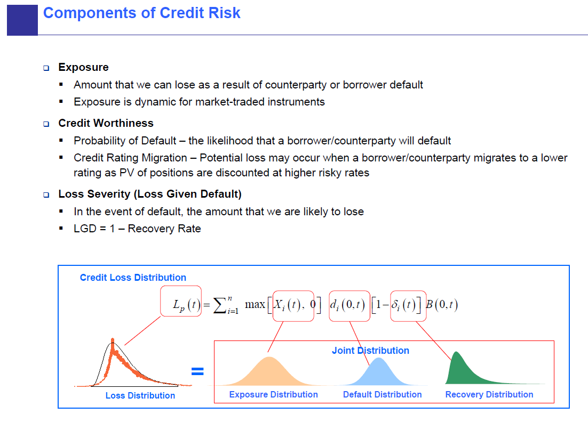

Slide 257
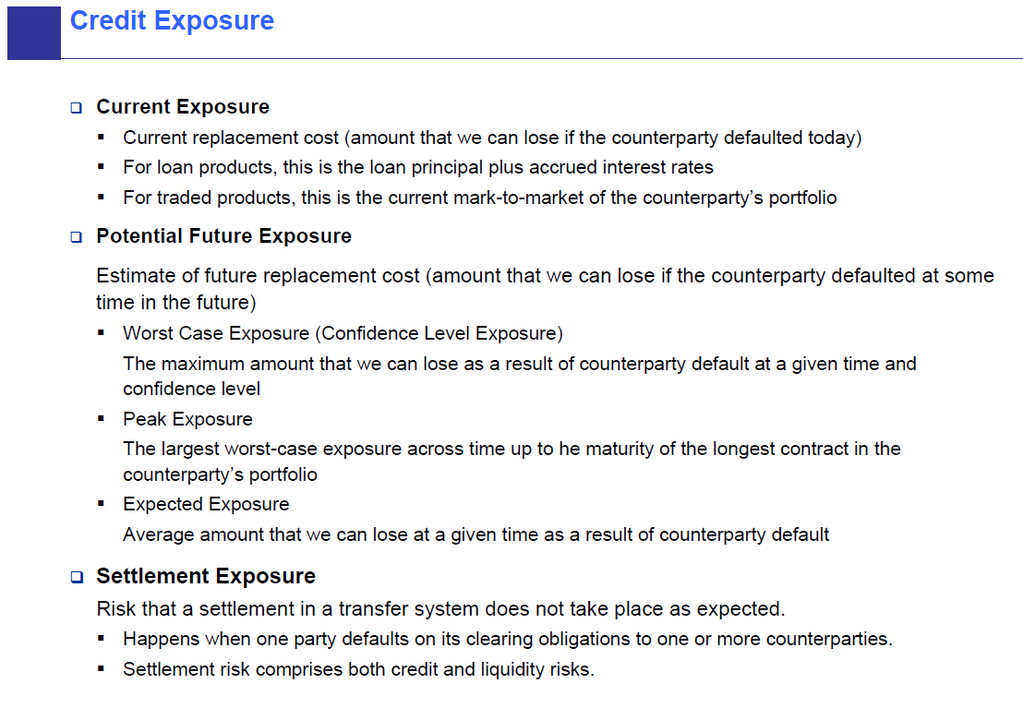

Slide 258
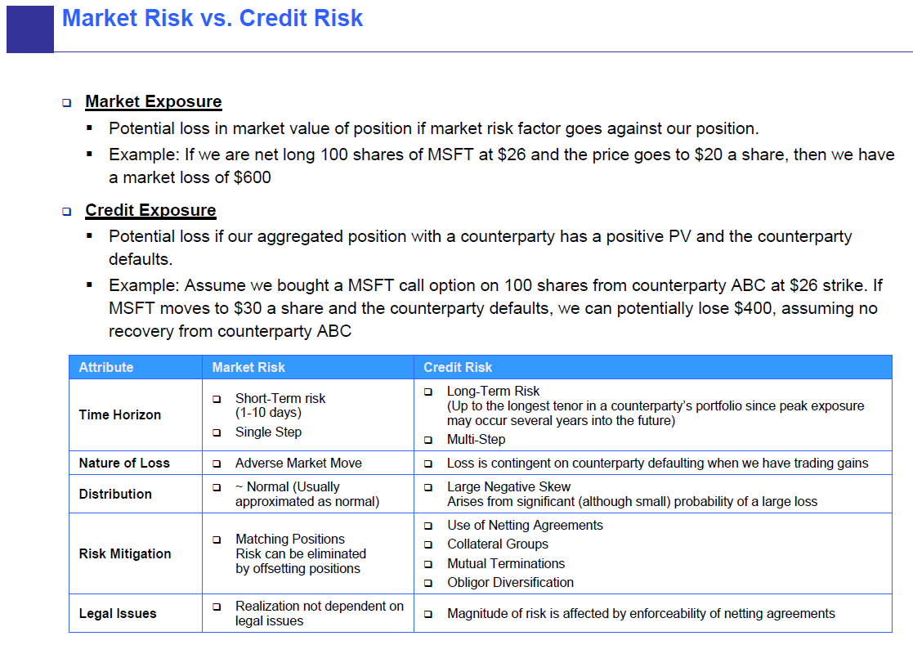

Slide 259
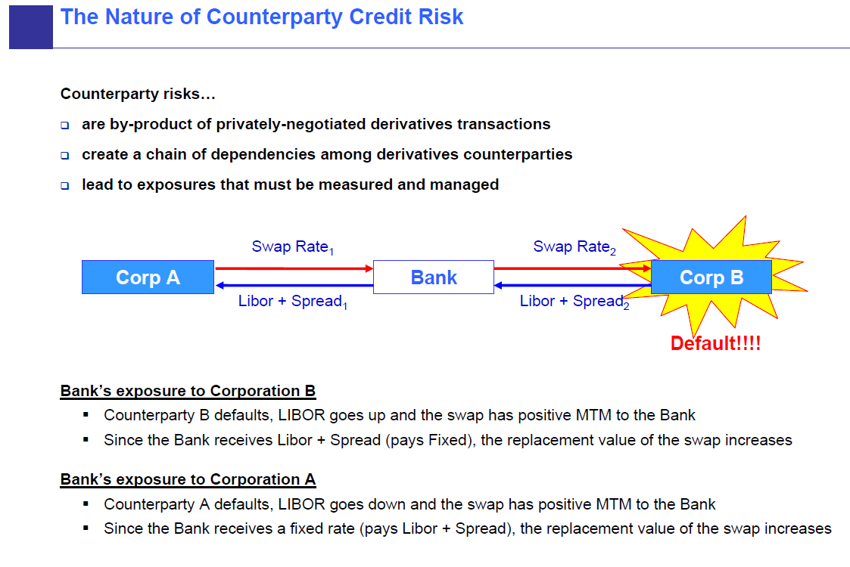

Slide 260
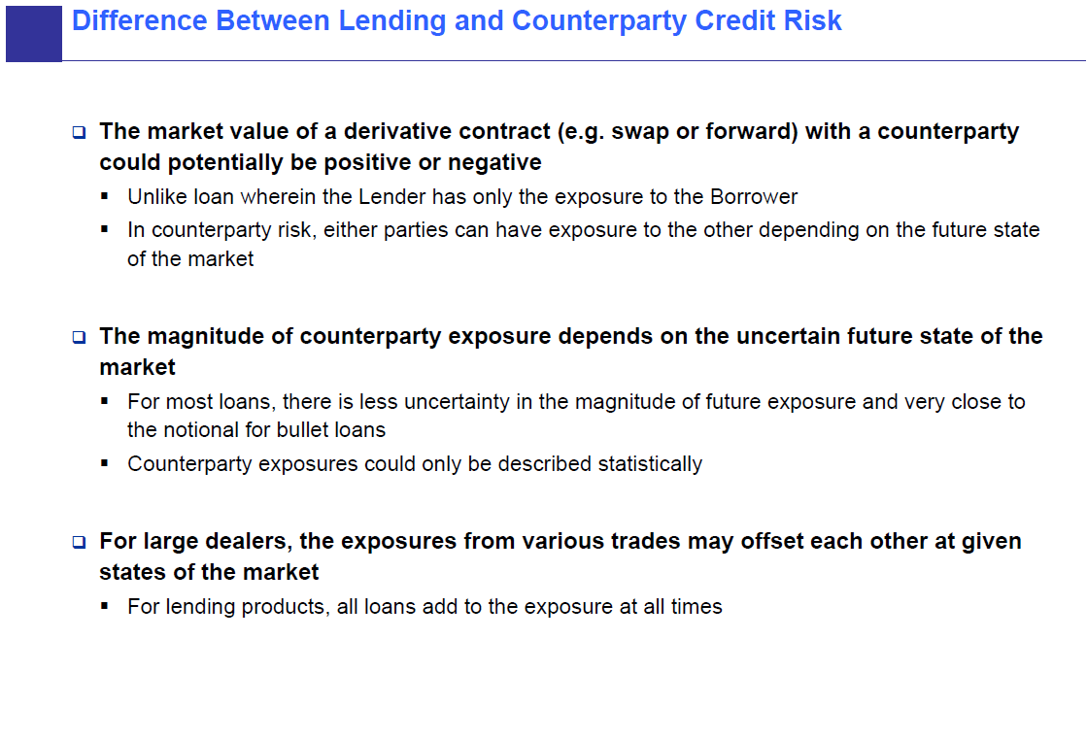

Slide 261
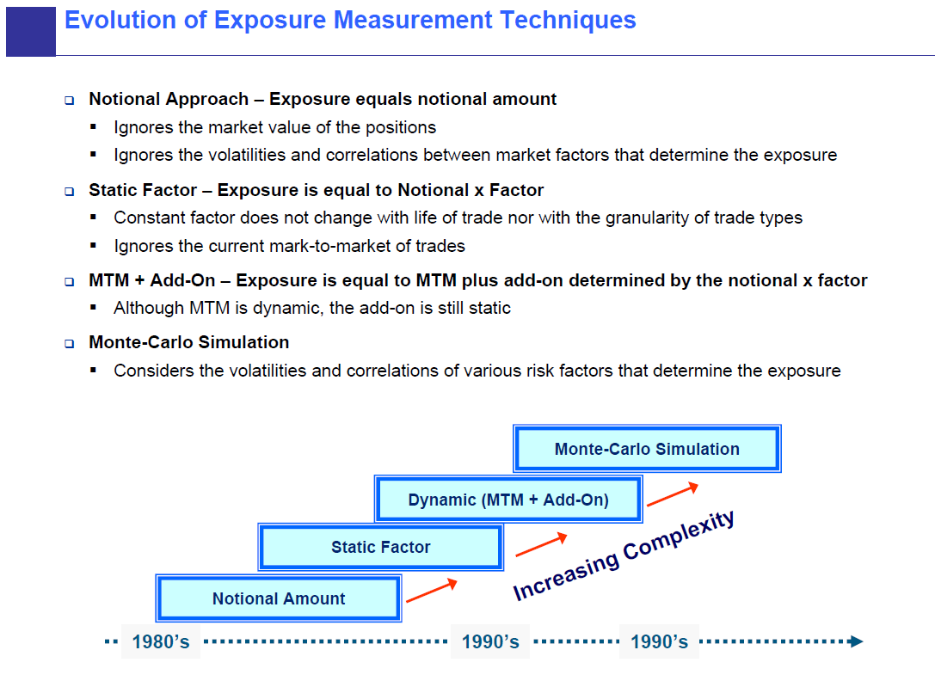

Slide 262
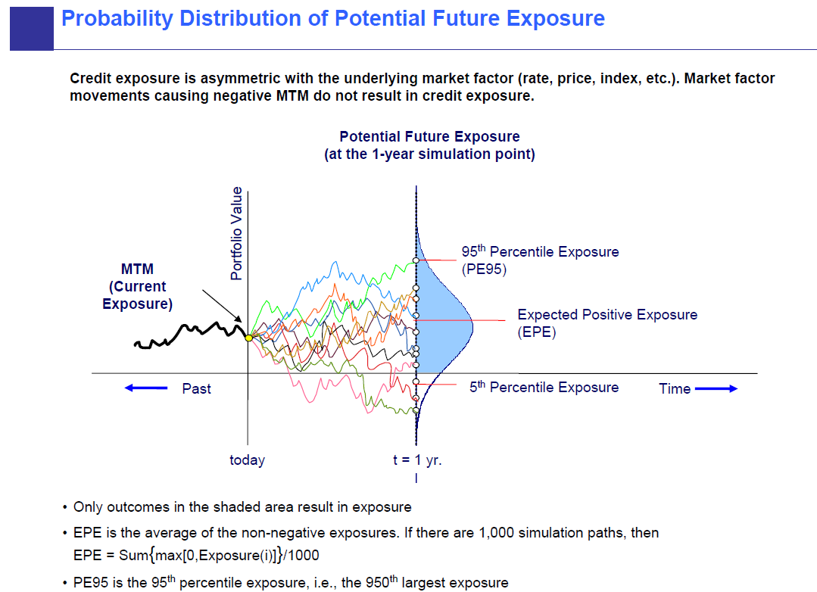

Slide 263
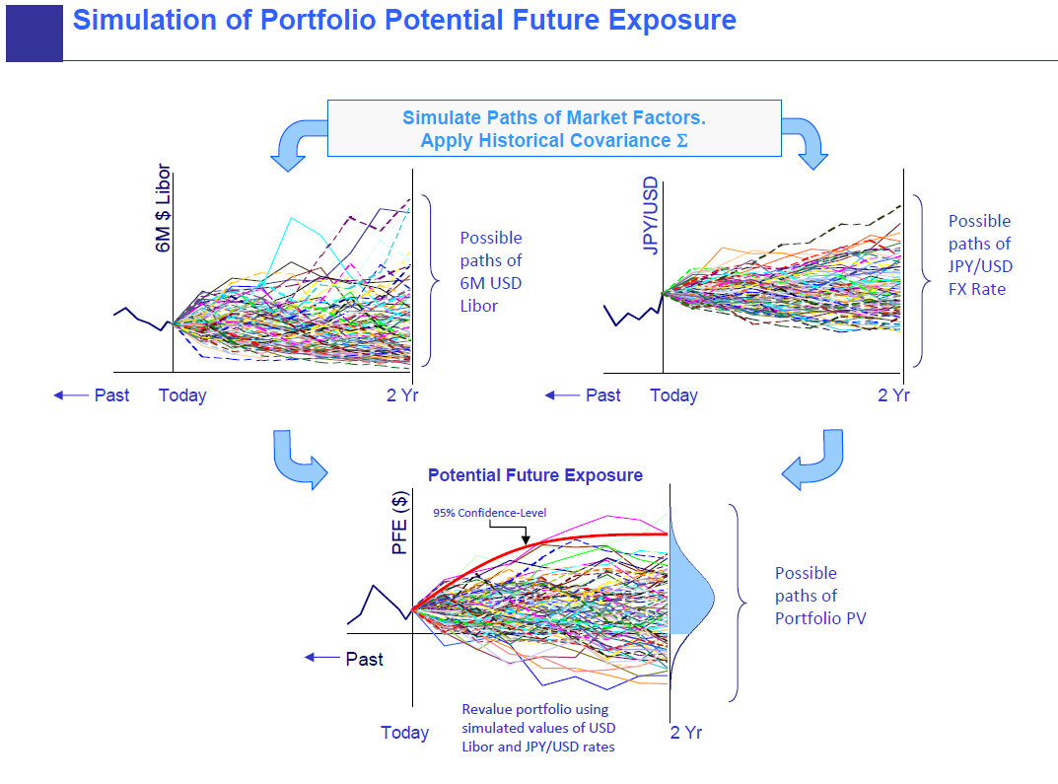

Slide 264
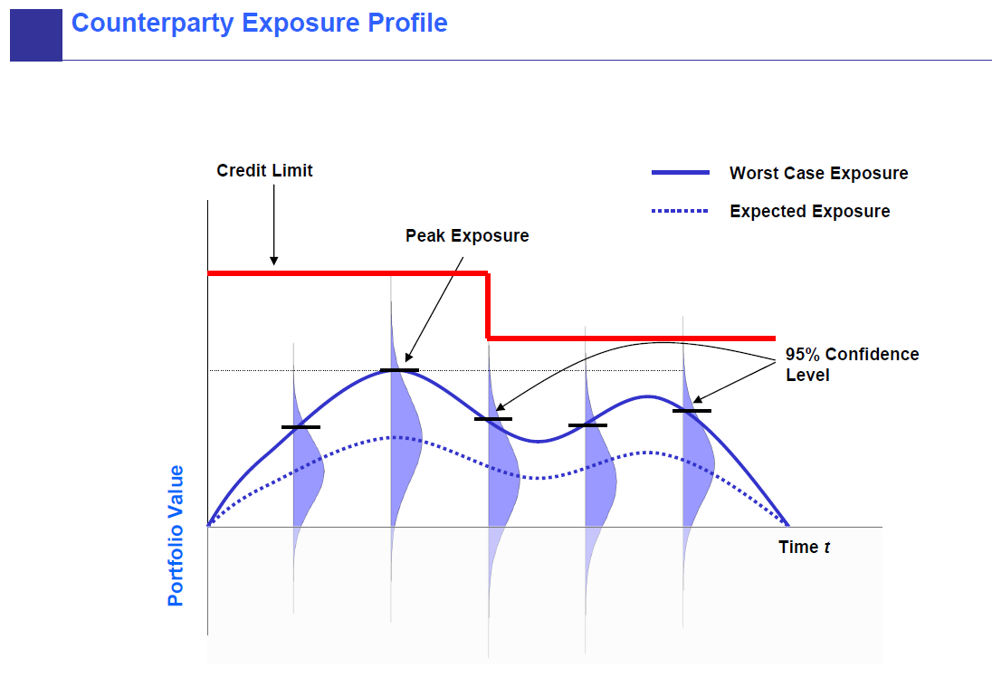

Slide 265
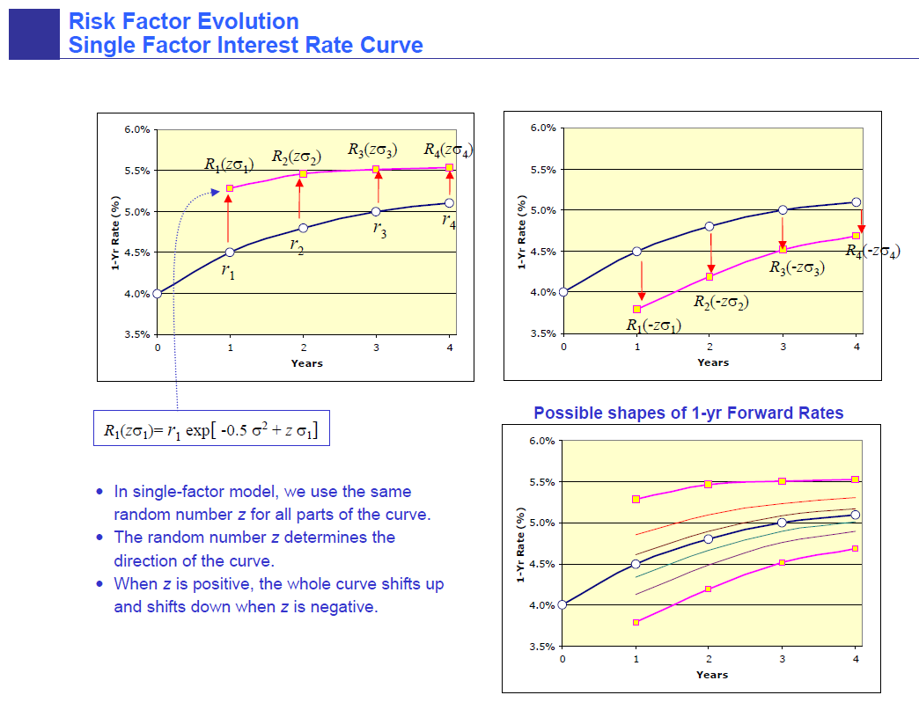

Slide 266
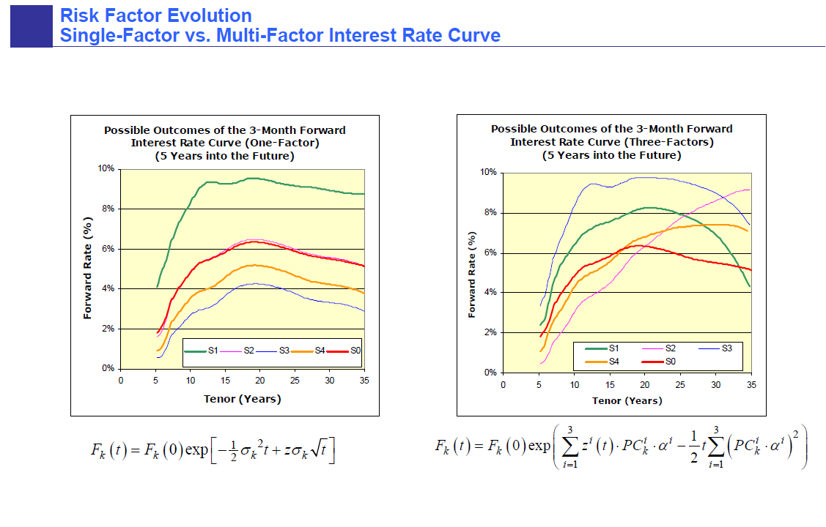

Slide 267
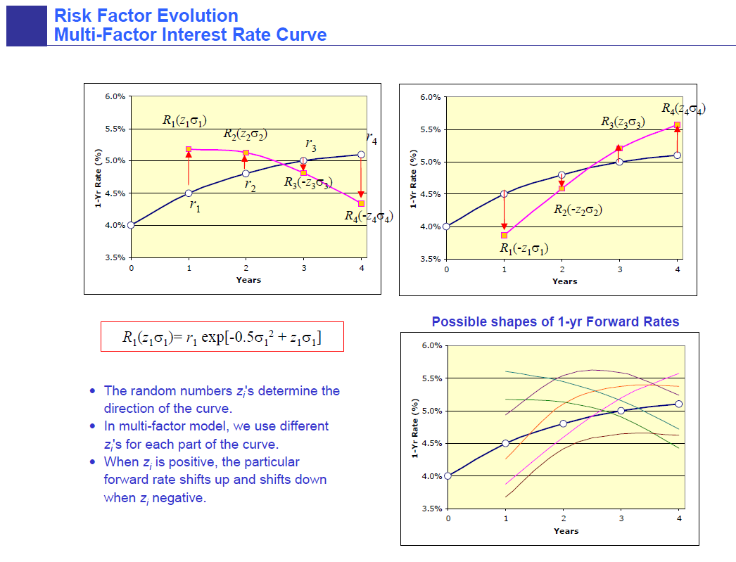

Slide 268
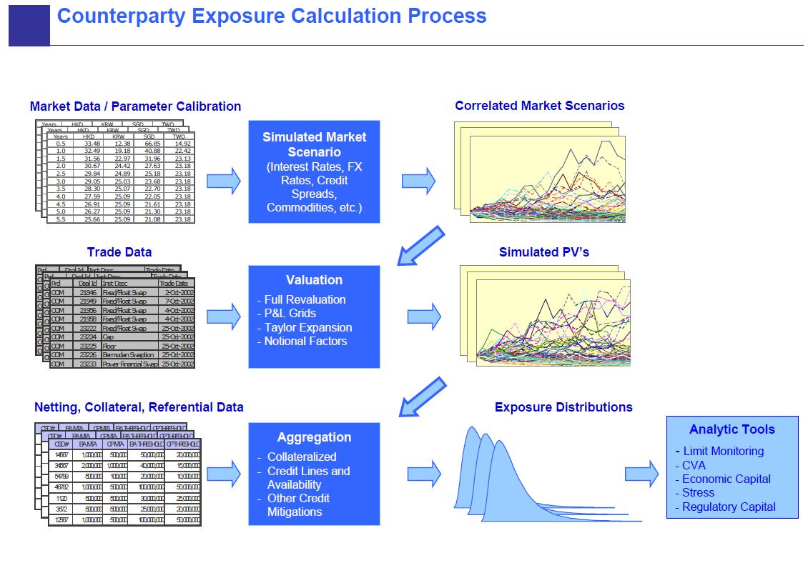

Slide 269
Limits

Slide 270
Limits Philosophy
Limits are a primary discussion point between Market Risk and the Business Units
Limits Setting Process
Limits should be set on VaR, Stress and greeks
Limits are designed to be frictional in nature, i.e. excesses are to be expected from time to time
Limits are generally set with the highest level requiring Risk Management signoff
Lower-level limits may be allocated within the BU
Limits Excesses
Whenever possible, excesses should be pre-cleared
Approved excesses should raised to the appropriate level of attention and be thoroughly documented
Unapproved excesses will not be tolerated
Limit Calibration
Calibration should be done to ensure consistency between greek and VaR limits and to ensure that desk-level var limits are consistent with each other
Cross-BU limit excesses (e.g. FX where several BU’s contribute to the total) generally require position reduction by the unit not primarily engaged in that business
Limits Governance
Limits must be reviewed annually by the Senior Management
Required excess approvals a function or excess period, limit level, excess amount

Slide 271
Why Limits?
Ensure that risk taking is commensurate with appetite
Point of contact between Risk and line
Liquidity constraints
Exchange rules
Regulatory requirements

Slide 272
Check Risk Appetite
Senior management determines general levels of different types of risks
Institutes institutional bias

Slide 273
Point of Contact
Who does Risk work for anyway?
What is driving increased position/risk?
New position
Current position gains value
Increased market vol
“Trigger” initiate discussion

Slide 274
Liquidity
single stock
bond issue
futures contract
options contract
illiquid market
munis
high yield

Slide 275
Exchange Rules
Exchanges have limits which often decline as expiry approaches
These are designed to prevent manipulation
Also important to ensure due diligence

Slide 276
Regulatory Requirements
Fed
OCC
FSA
CFTC
FINRA
SEC

Slide 277
Limits
position

Slide 278
Limits
CMV limits
position

Slide 279
Limits
CMV limits
DV01 limits
position

Slide 280
Limits
CMV limits
DV01 limits
VaR limits
position

Slide 281
Types of Limits: Structure
Approval by Committee
Proper governance
Escalation Process
Tiers
Guidelines
Sublimits

Slide 282
Desk Level Limits
“Owned” by the line
Advised
Can be disputed by Risk Management
Often MV or DV01-based
Intraday limits
Stops

Slide 283
Types of Market Risk Limits
FX exposure
Gross exposure
Net exposure
Index equivalent
Single name
Country
Correlation PV01
CMV
PV01
Spread PV01
Spread PV10%
JTD
Vega
Gamma

Slide 284
Types of Credit Risk Limits
Level
Desk
Credit Risk Committee
Senior Management
Type
Gross Exposure Net Exposure Relationship
PE95 ` Loan Inventory
Country Exp Industry Exp Product Exp
Settlement Event Product

Slide 285
IR Delta
Total
Limit
($MM)

Slide 286
Limits Usage Examples
Business A: LIMITS USAGE ANALYSIS
10 DAY (BIS) VAR
80
70
60
50
40
30
20
Business A
10
LIMIT
0
1/2/97
1/16/97
1/30/97
2/13/97
2/27/97
3/13/97
3/27/97
4/10/97
4/24/97
5/8/97
5/22/97
6/5/97
6/19/97
7/3/97
7/17/97
7/31/97
8/14/97
8/28/97
9/11/97

Slide 287
Limits Usage Examples
Business B: LIMITS USAGE ANALYSIS
10 DAY (BIS) VAR
120
100
80
60
40
Business B
20
LIMIT
0
1/2/97
1/16/97
1/30/97
2/13/97
2/27/97
3/13/97
3/27/97
4/10/97
4/24/97
5/8/97
5/22/97
6/5/97
6/19/97
7/3/97
7/17/97
7/31/97
8/14/97
8/28/97
9/11/97

Slide 288
Setting Limits
Political climate
Hard limits
Advised limits
Analysis
level of activity
size of positions
number of positions
liquidity of market

Slide 289
Setting Limits
Risk/Reward
Product Liquidity
Product Volatility
Markets Acceptance of Bank’s Name
Experience of the Traders
Strength of Operations and Internal Controls

Slide 290
Calibrating Limits
Two very different approaches I’ve taken:
VaR top level to VaR lower Level
VaR to greeks
Both are very subjective
However, neither criticized by regulators
MUST BE MAPPED TO RISK TOLERANCE

Slide 291
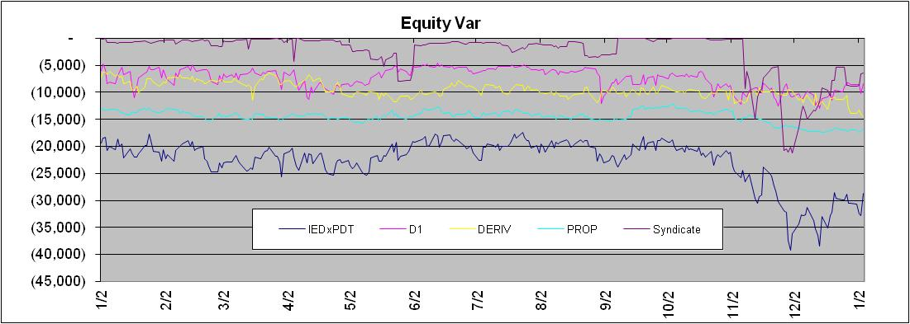
Calibrating Limits
Spreadsheet Example:

Slide 292
Calibrating Greeks
Take top-level greeks
Assign simple benchmarks
Equity indices
FI Total Return Indices
Basic Commodities
Major FX or FX Indices
Assume max usage
Run VaR, compare

Slide 293
Monitoring Limits
Dealing With Exceptions
genesis
change in position size
change in value
change in volatility
change in historical data
ex-post knowledge vs ex-ante knowledge
the escalation process
reporting

Slide 294
Reporting Limits Usage
Every limit must be reported, every day
Some reporting done automatically
Others are part of the daily reporting process

Slide 295
Market Risk Limit Structure Overview
* Limit for major legal entities are also subject to respective governance processes
** Not MRD Owned

Slide 296
IRCC IR/FX/EM
Note
Limits co-owned by MRD and the Front Office

Slide 297
IRCC Excluding CVA, Lending and EM Non-core
Note
Limits co-owned by MRD and the Front Office

Slide 298
IRCC FXEM Single Name
Note
Limits co-owned by MRD and the Front Office

Slide 299
IRCC FX Vega Limits
Note
Limits co-owned by MRD and the Front Office

